Slide 1
Lake Washington Chapter
Introduction

Slide 2
Lake Washington Chapter
Exhibitions
花展
A sample of our thirty-one exhibitions since 2002

Slide 3
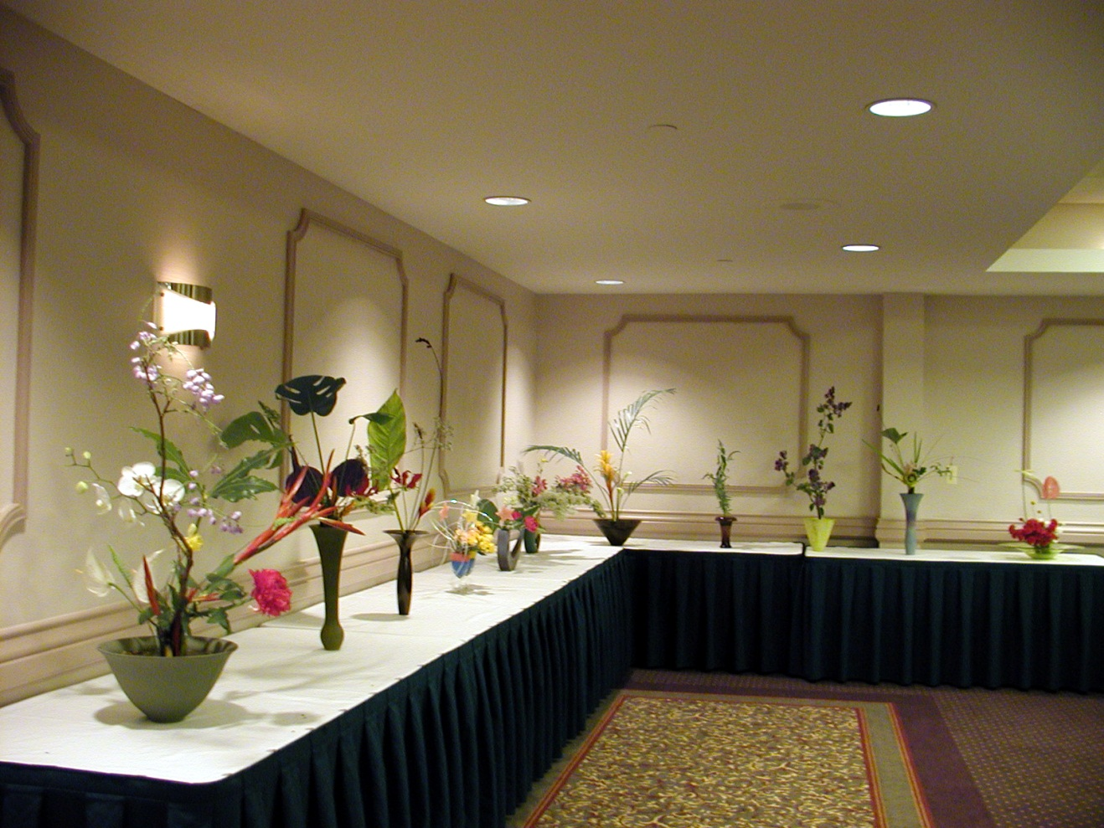

Slide 4
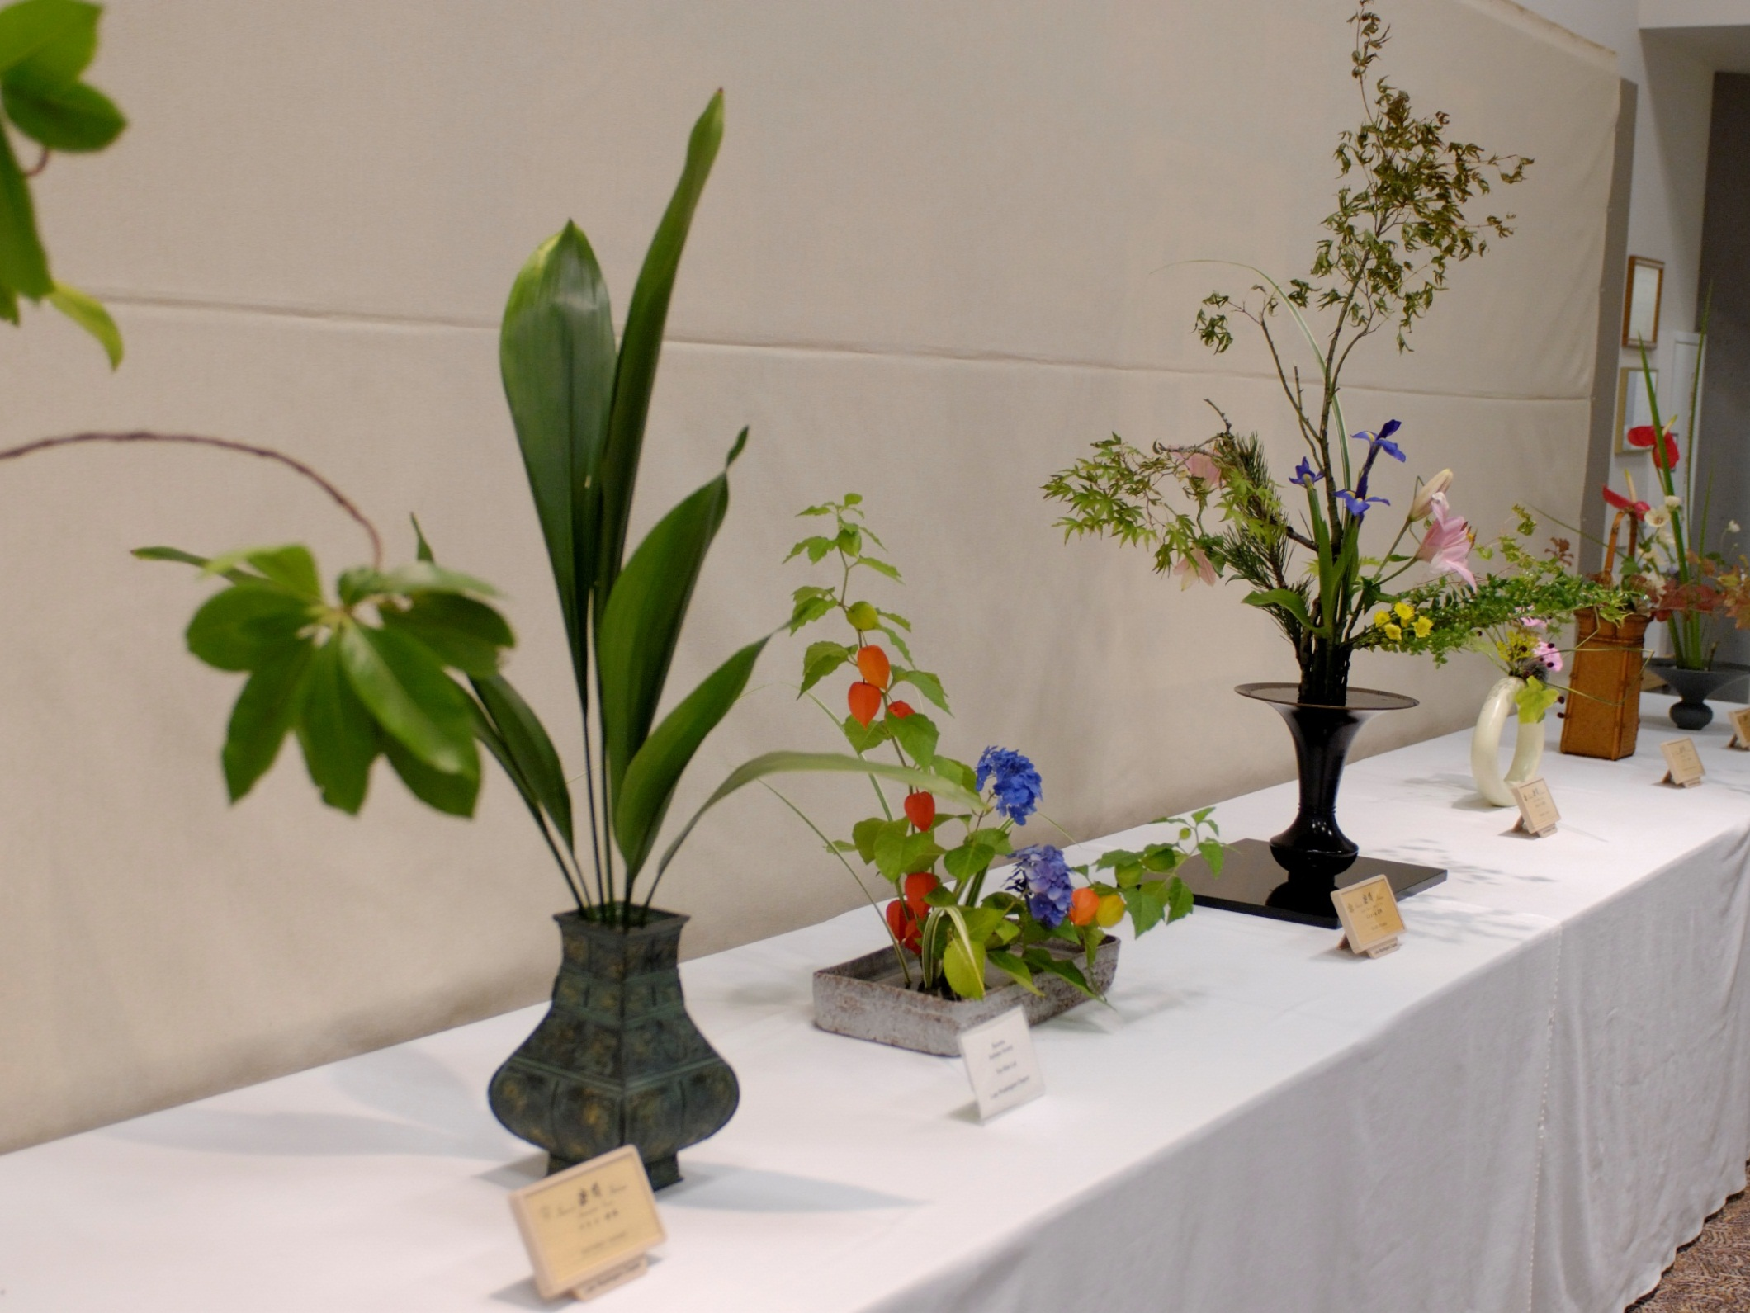

Slide 5
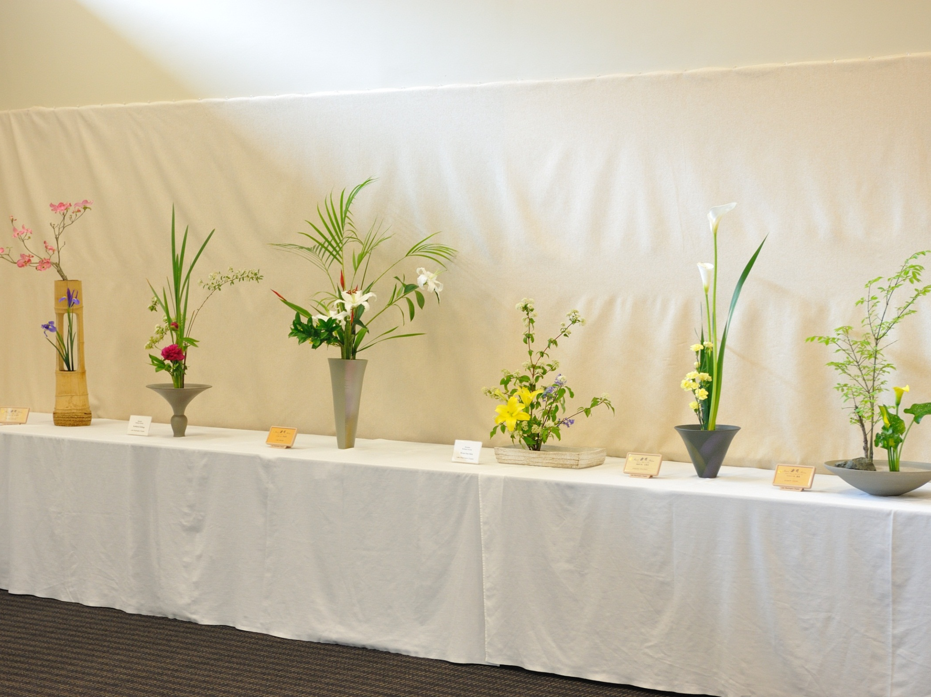

Slide 6
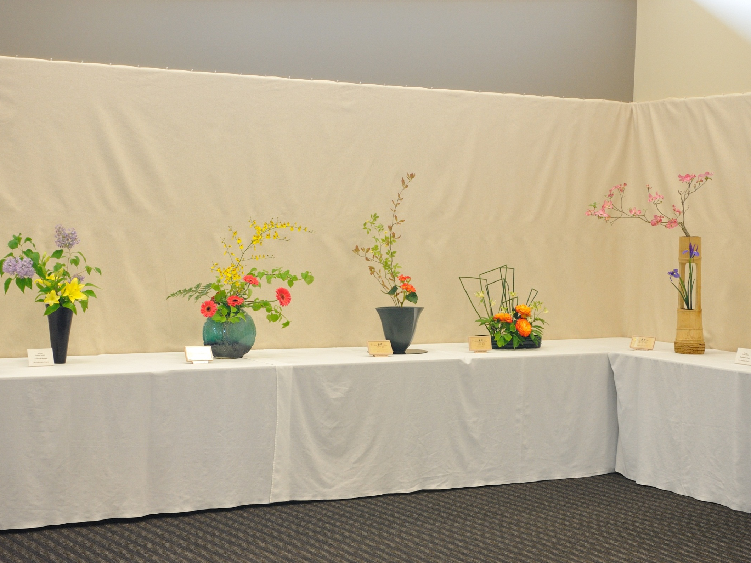

Slide 7
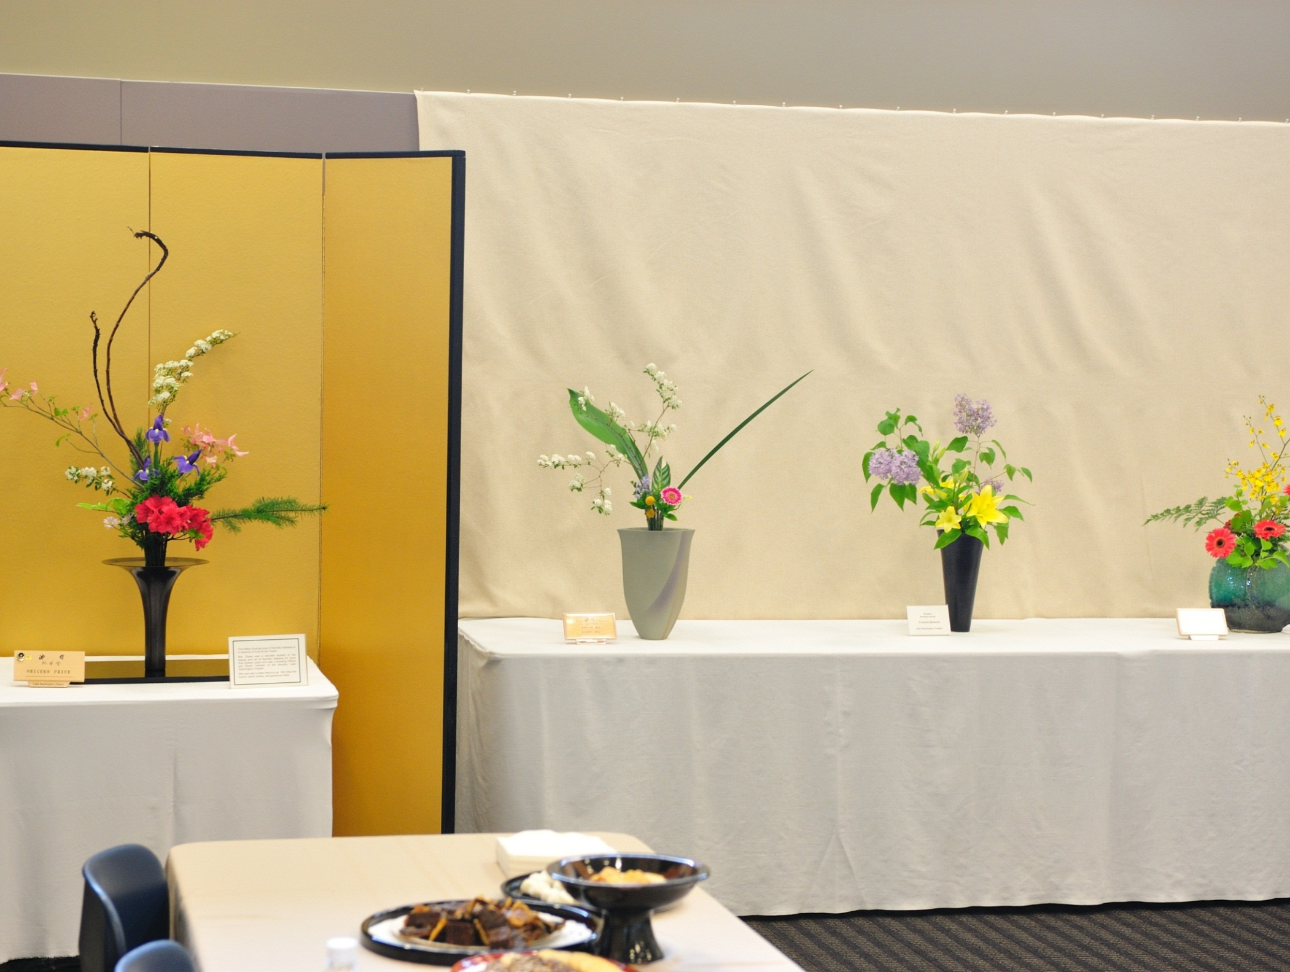

Slide 8
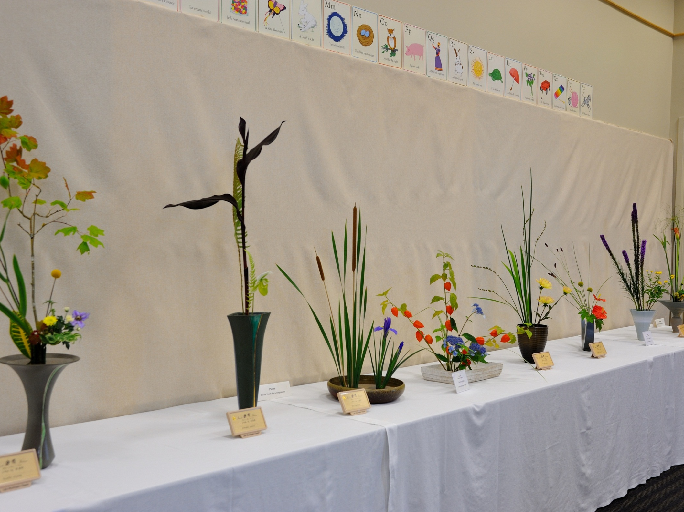

Slide 9
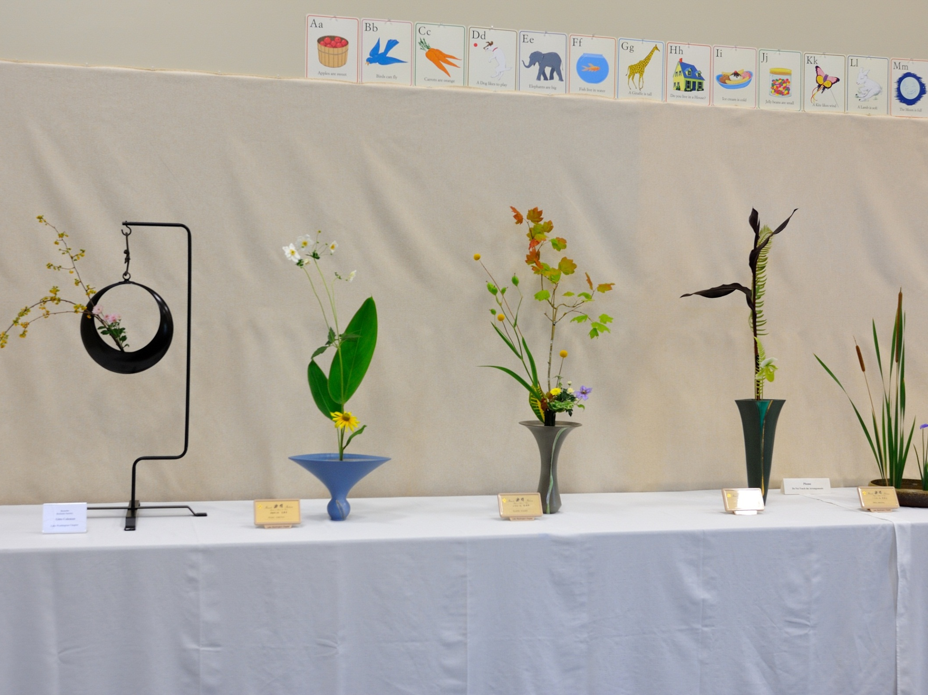

Slide 10
Our Gallery pages show more Ikebana

Slide 11
Lake Washington Chapter
Workshop Activity
講習会

Slide 12
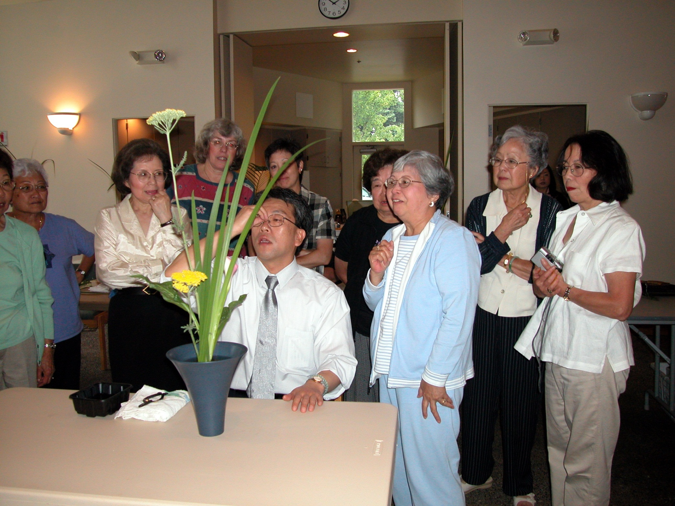

Slide 13
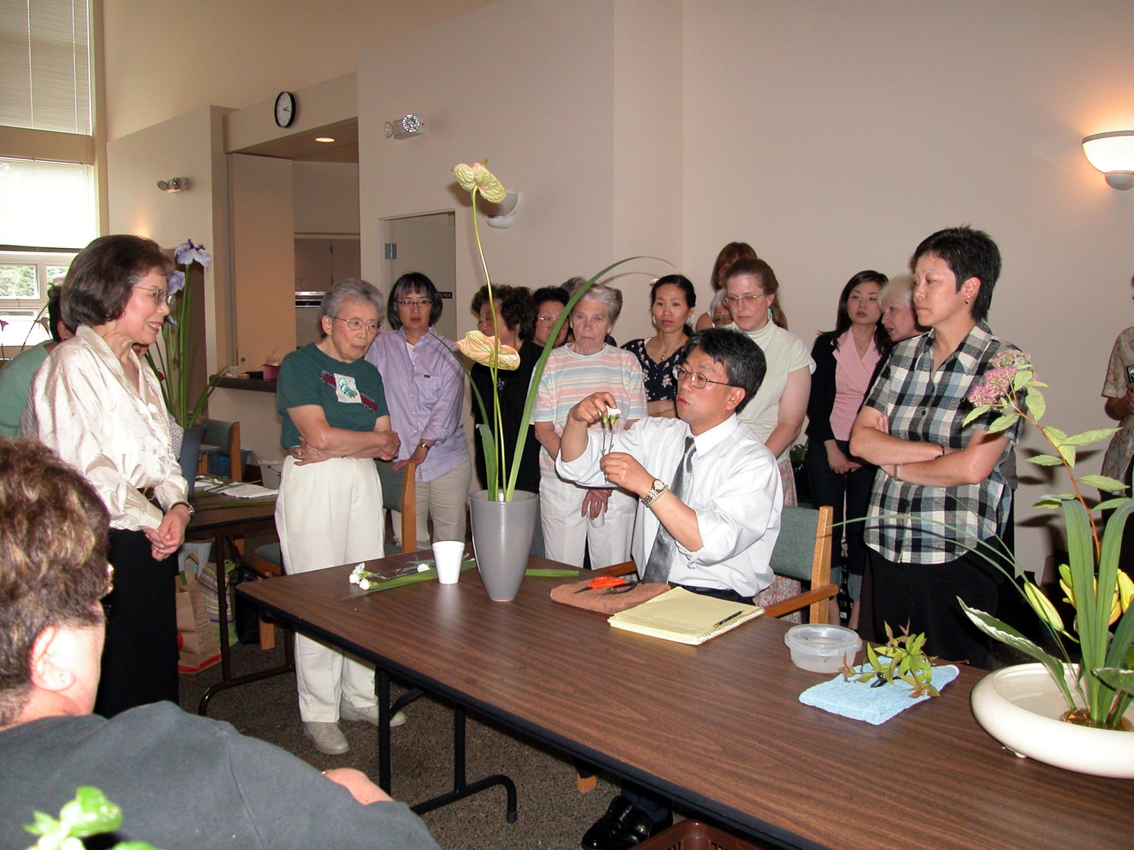

Slide 14
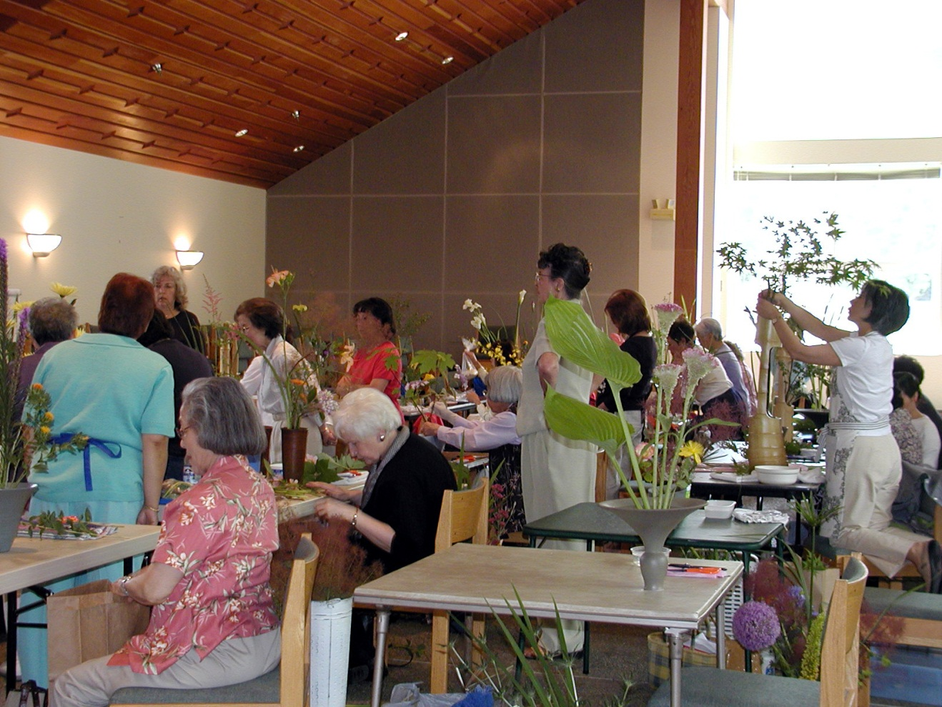

Slide 15
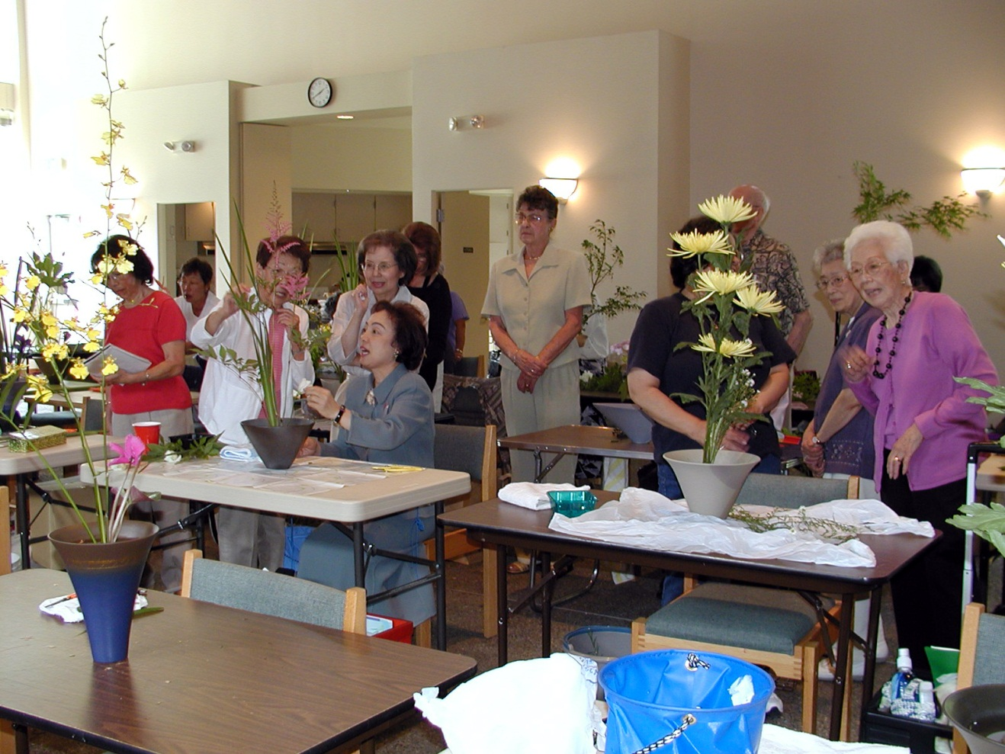

Slide 16
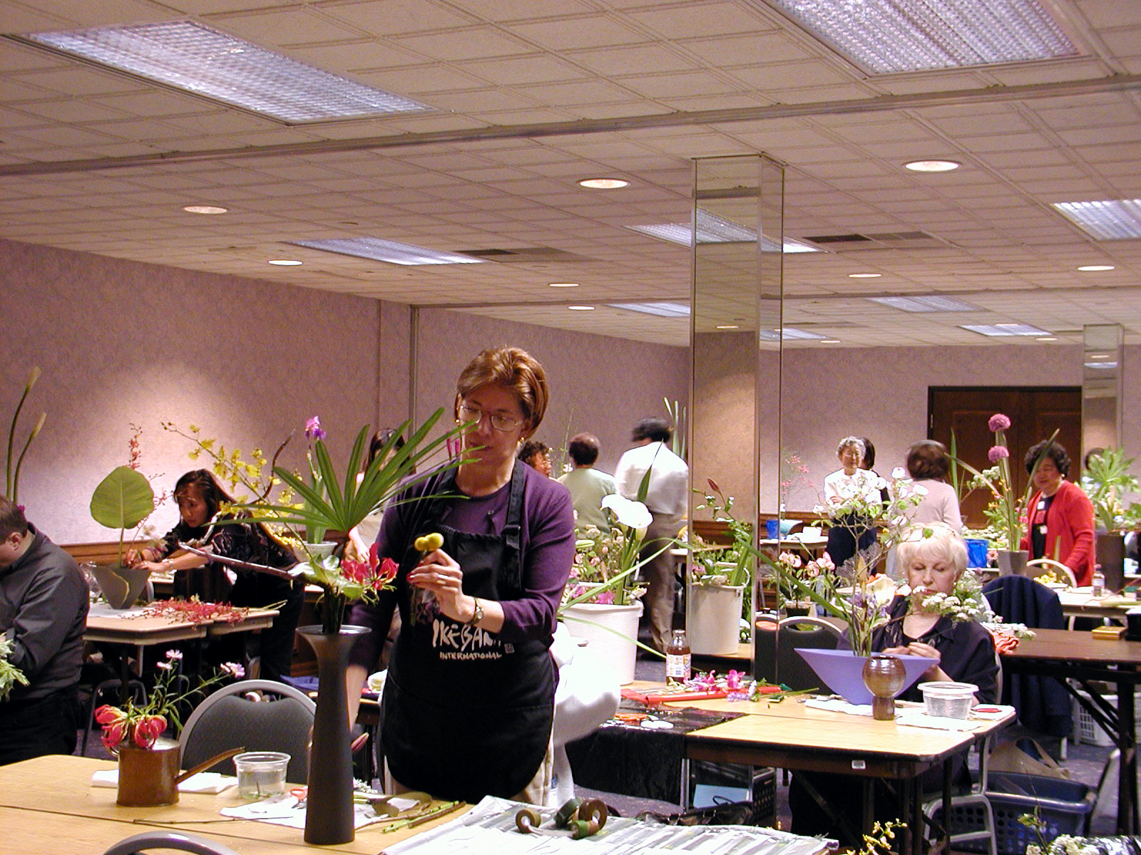

Slide 17
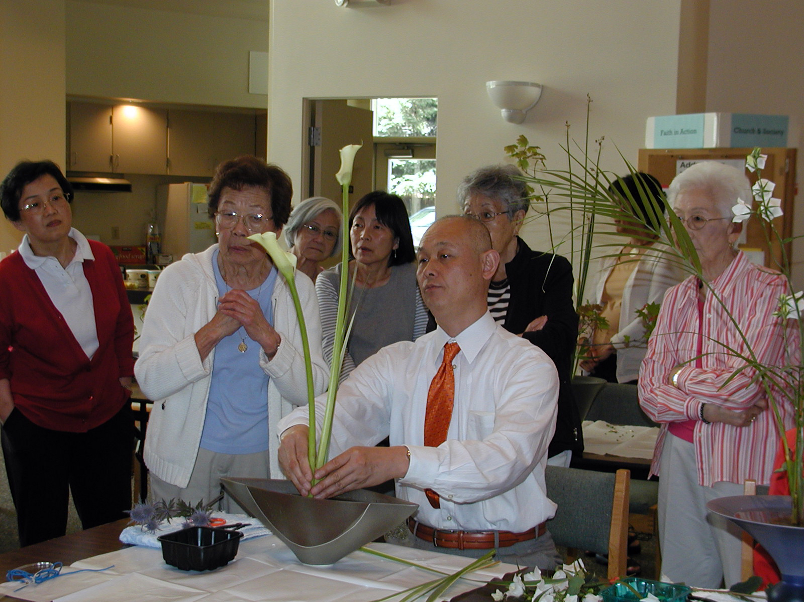

Slide 18
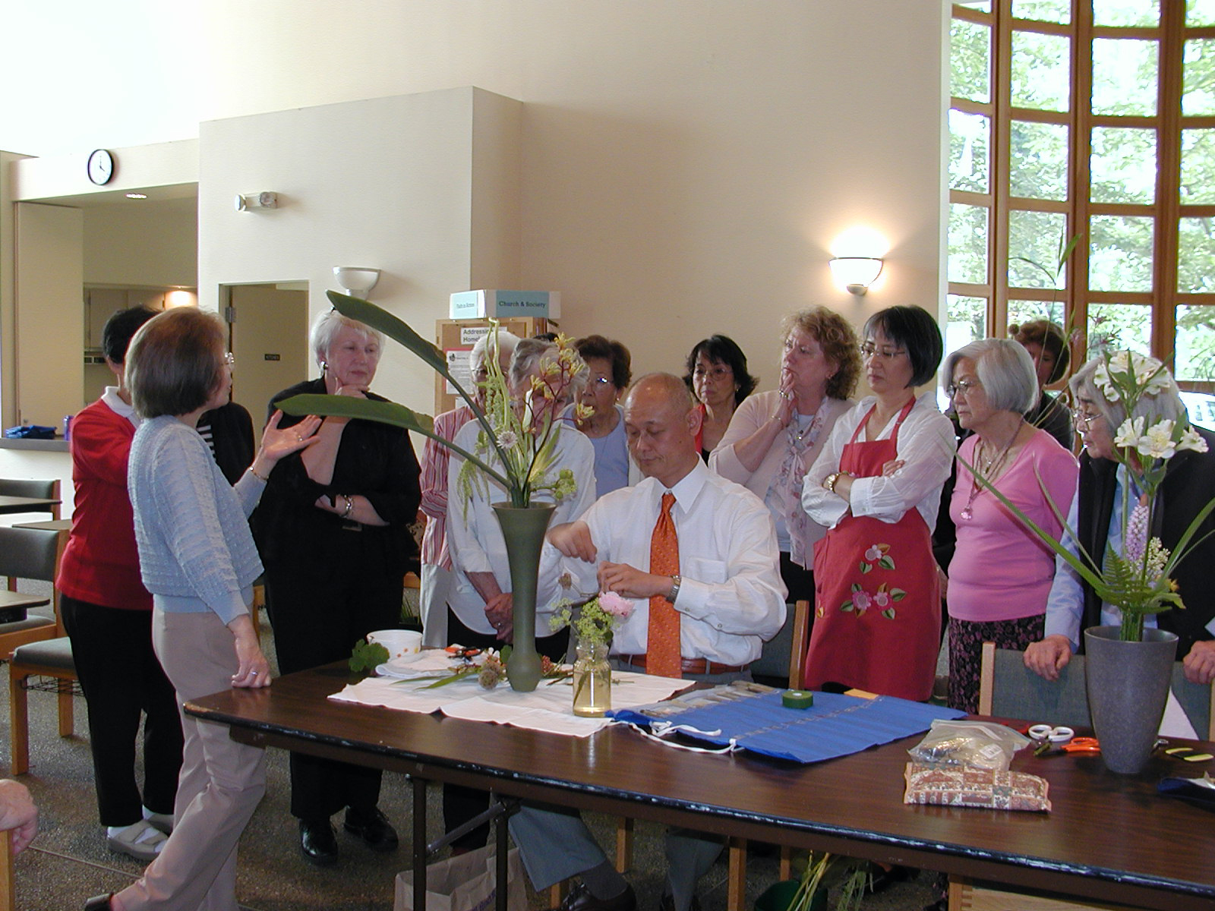

Slide 19
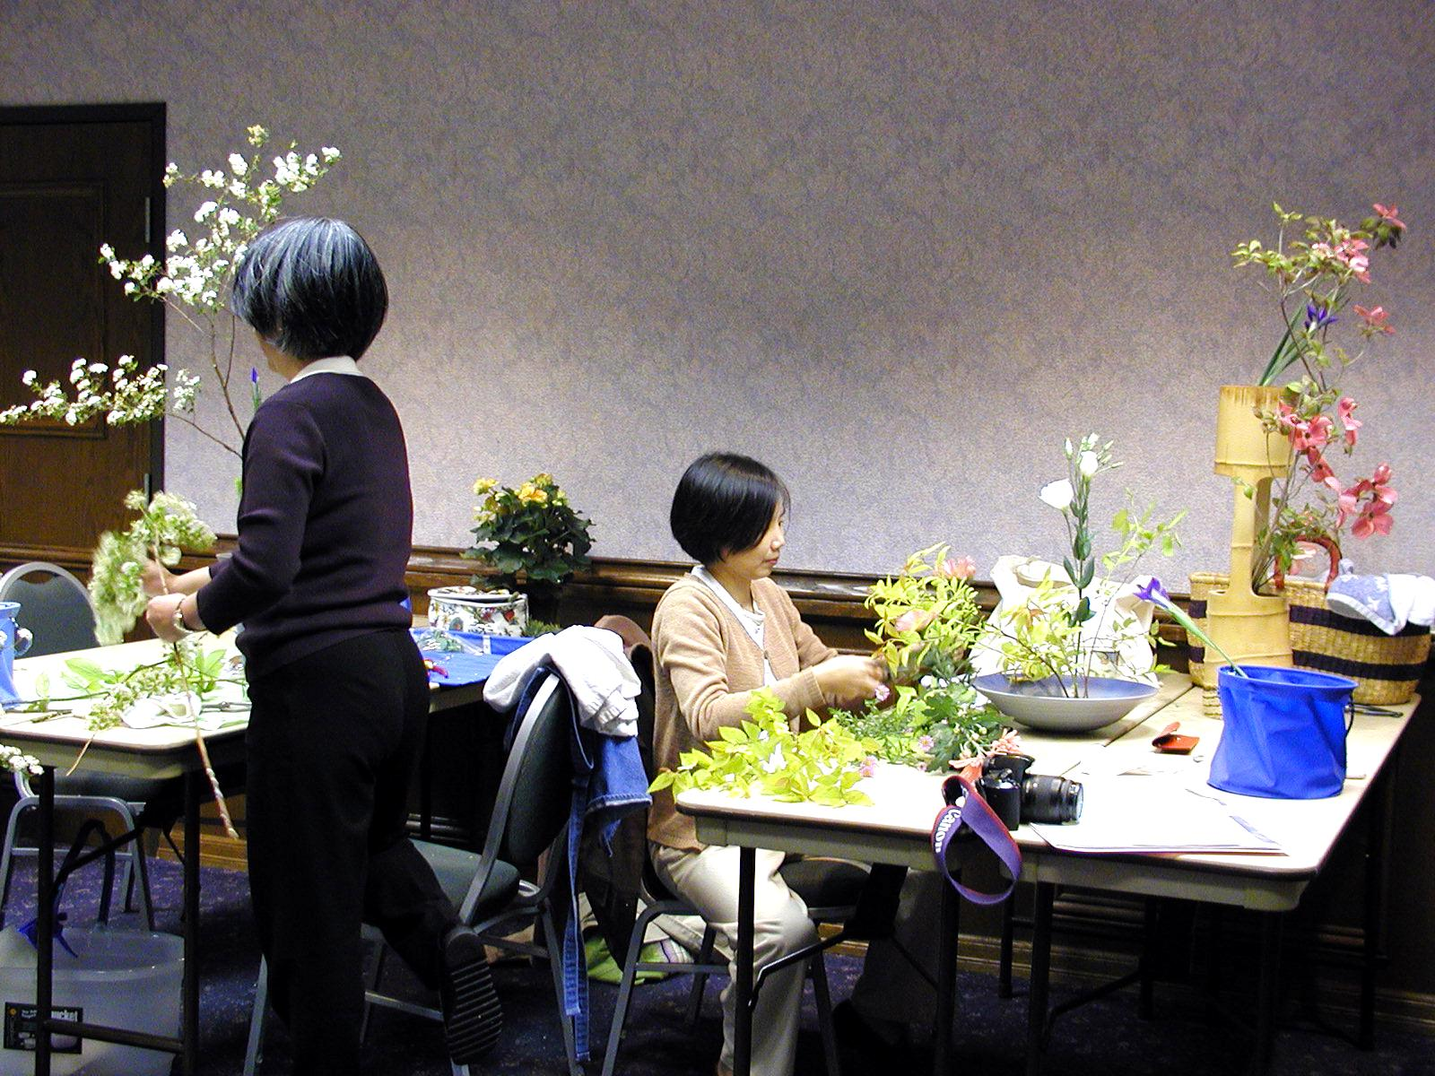

Slide 20
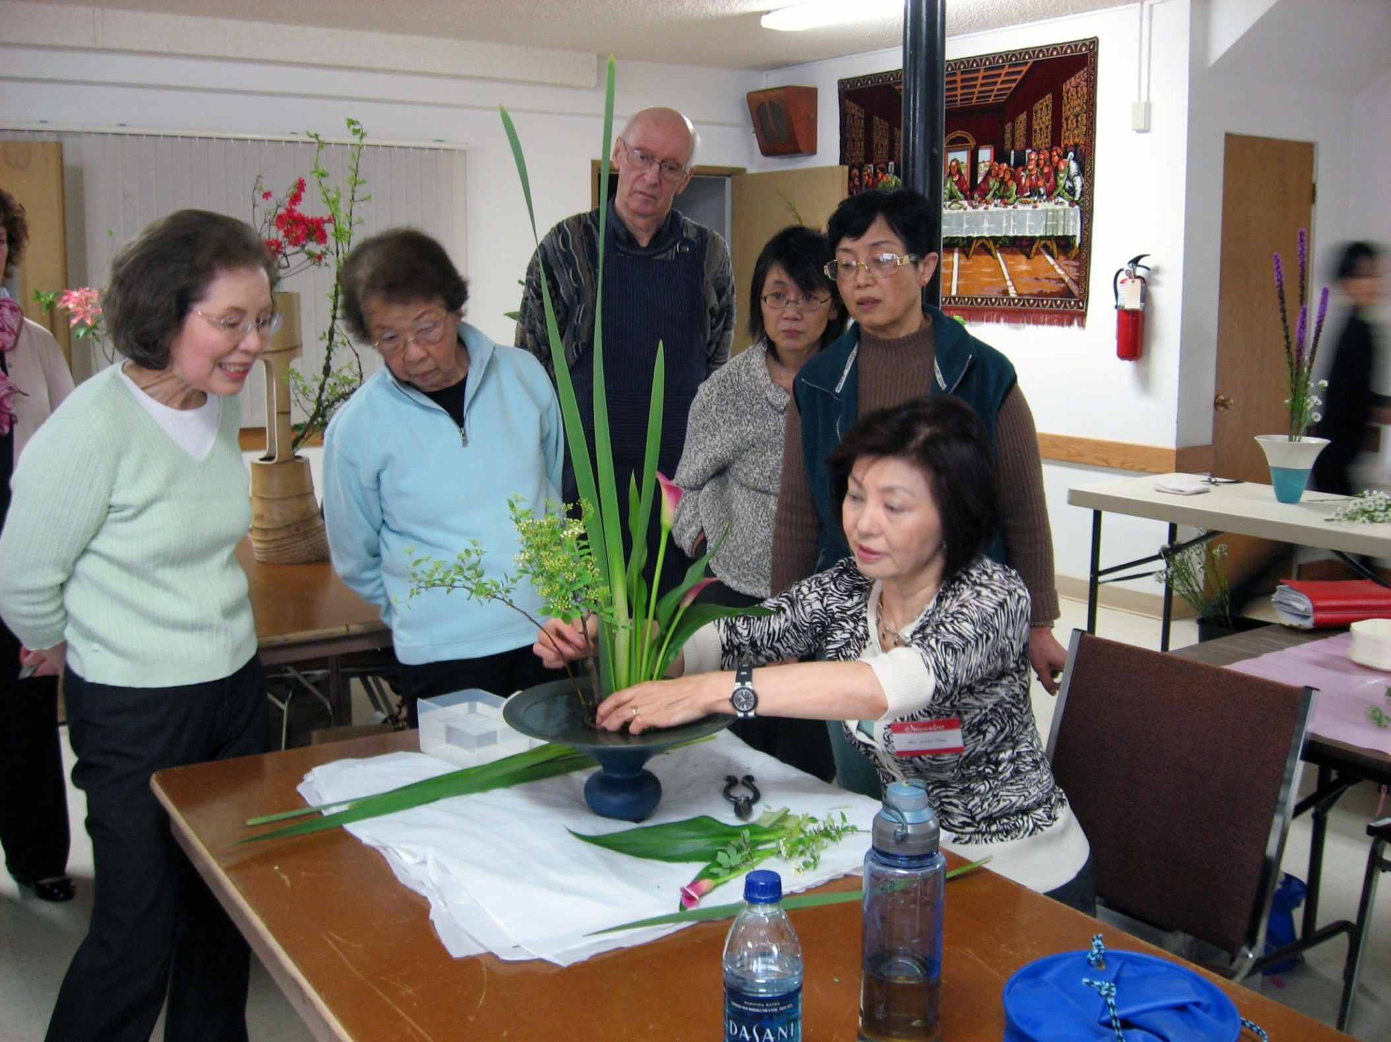

Slide 21
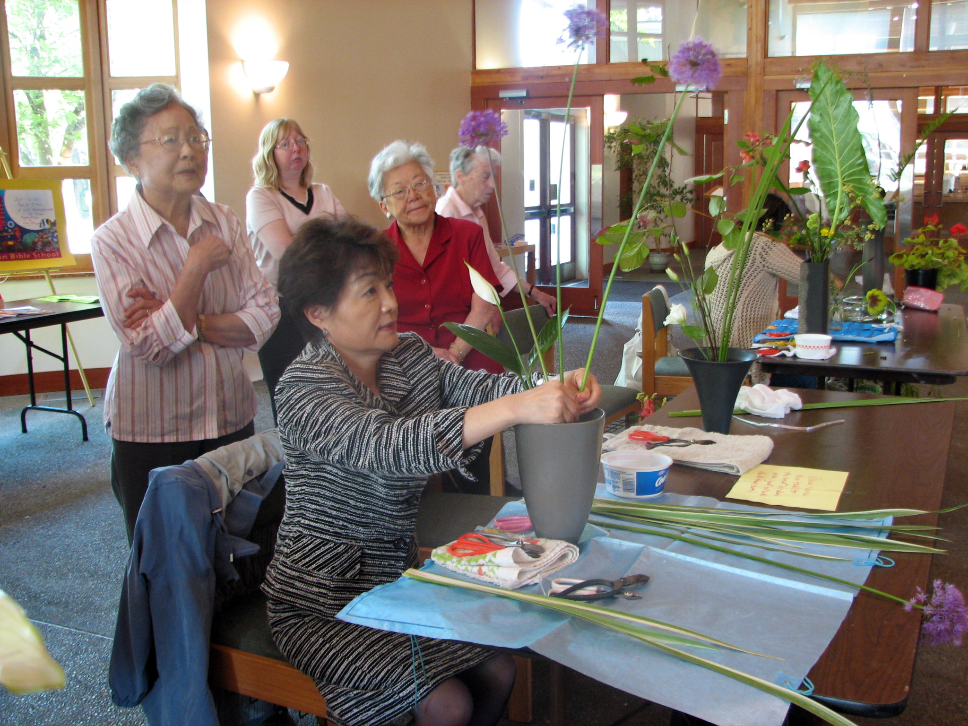

Slide 22
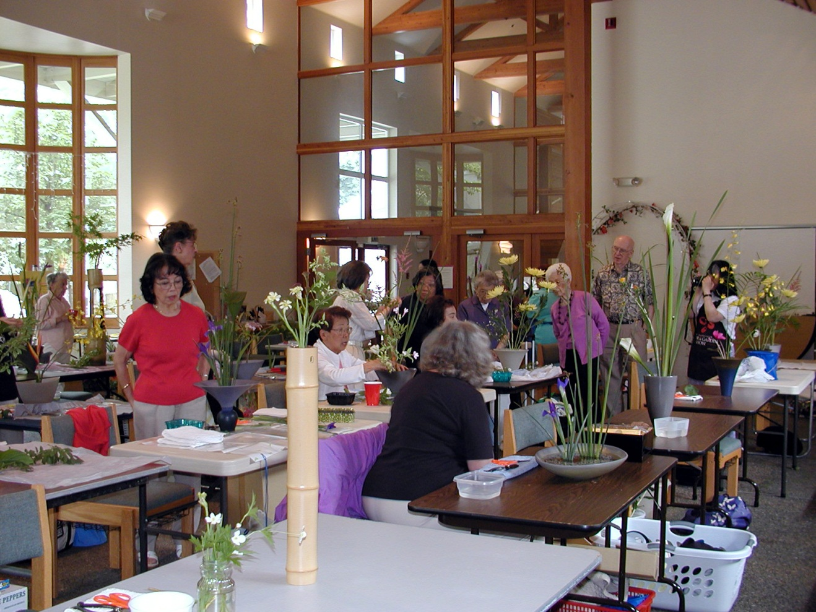

Slide 23
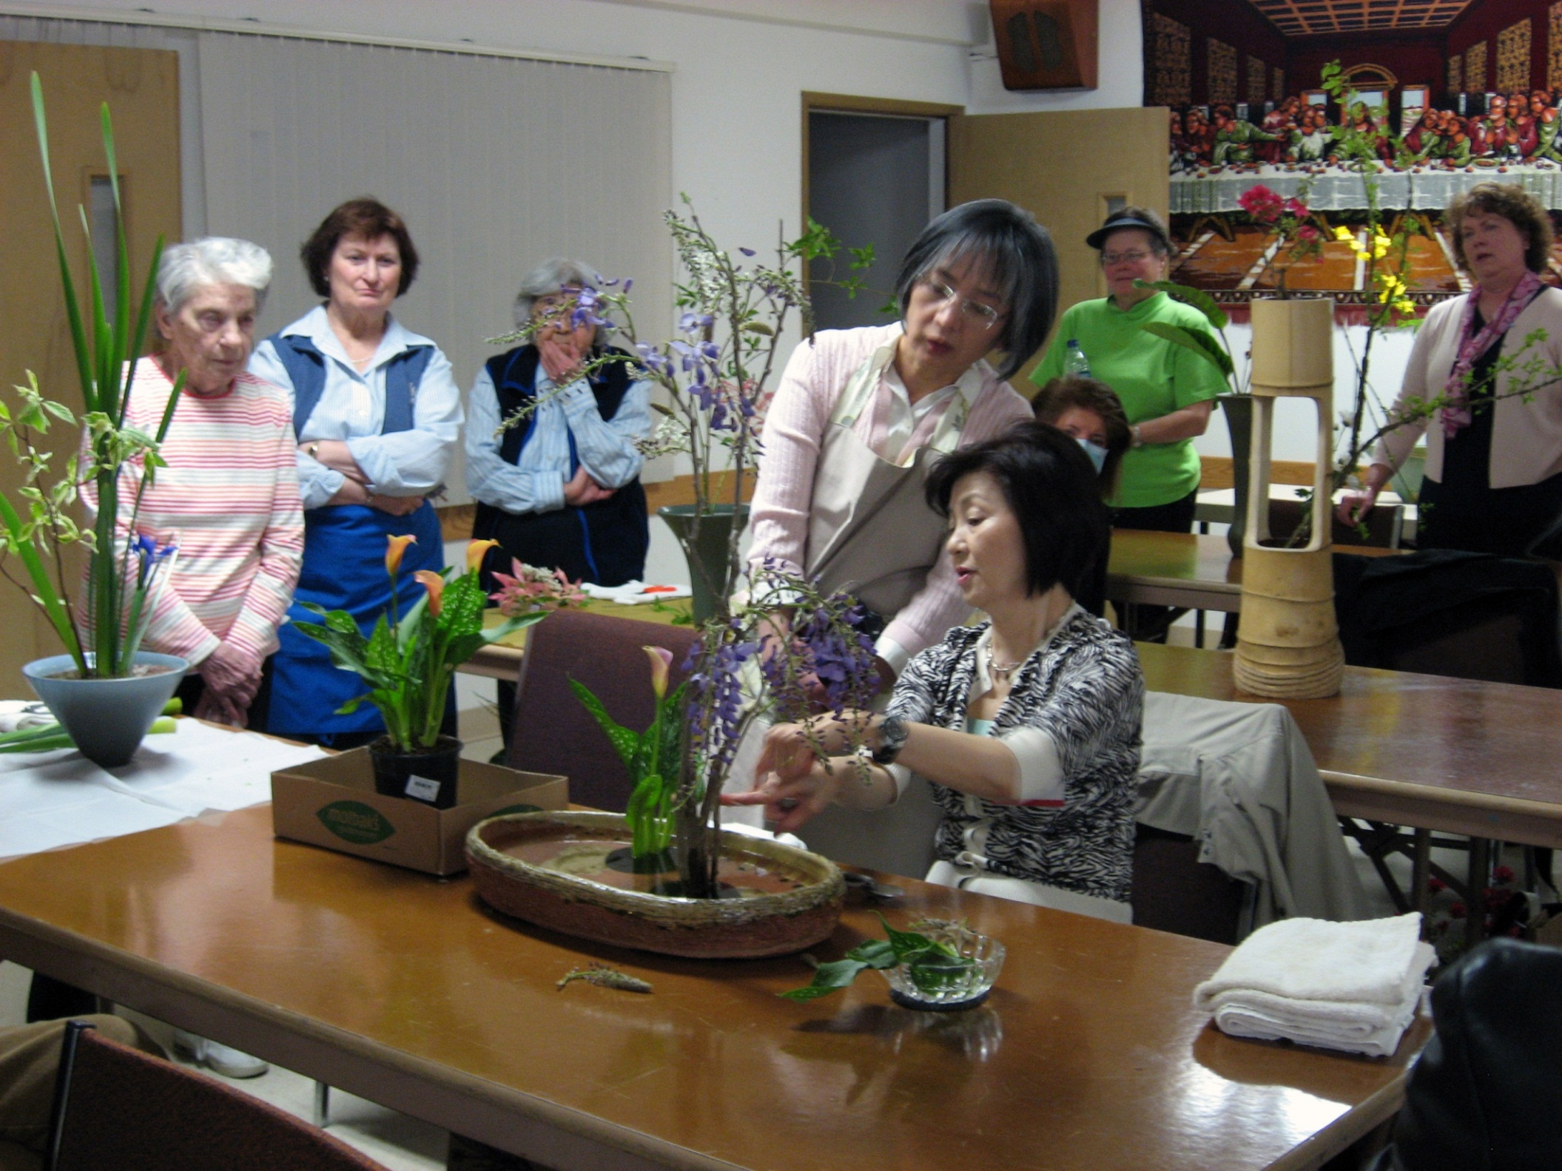

Slide 24
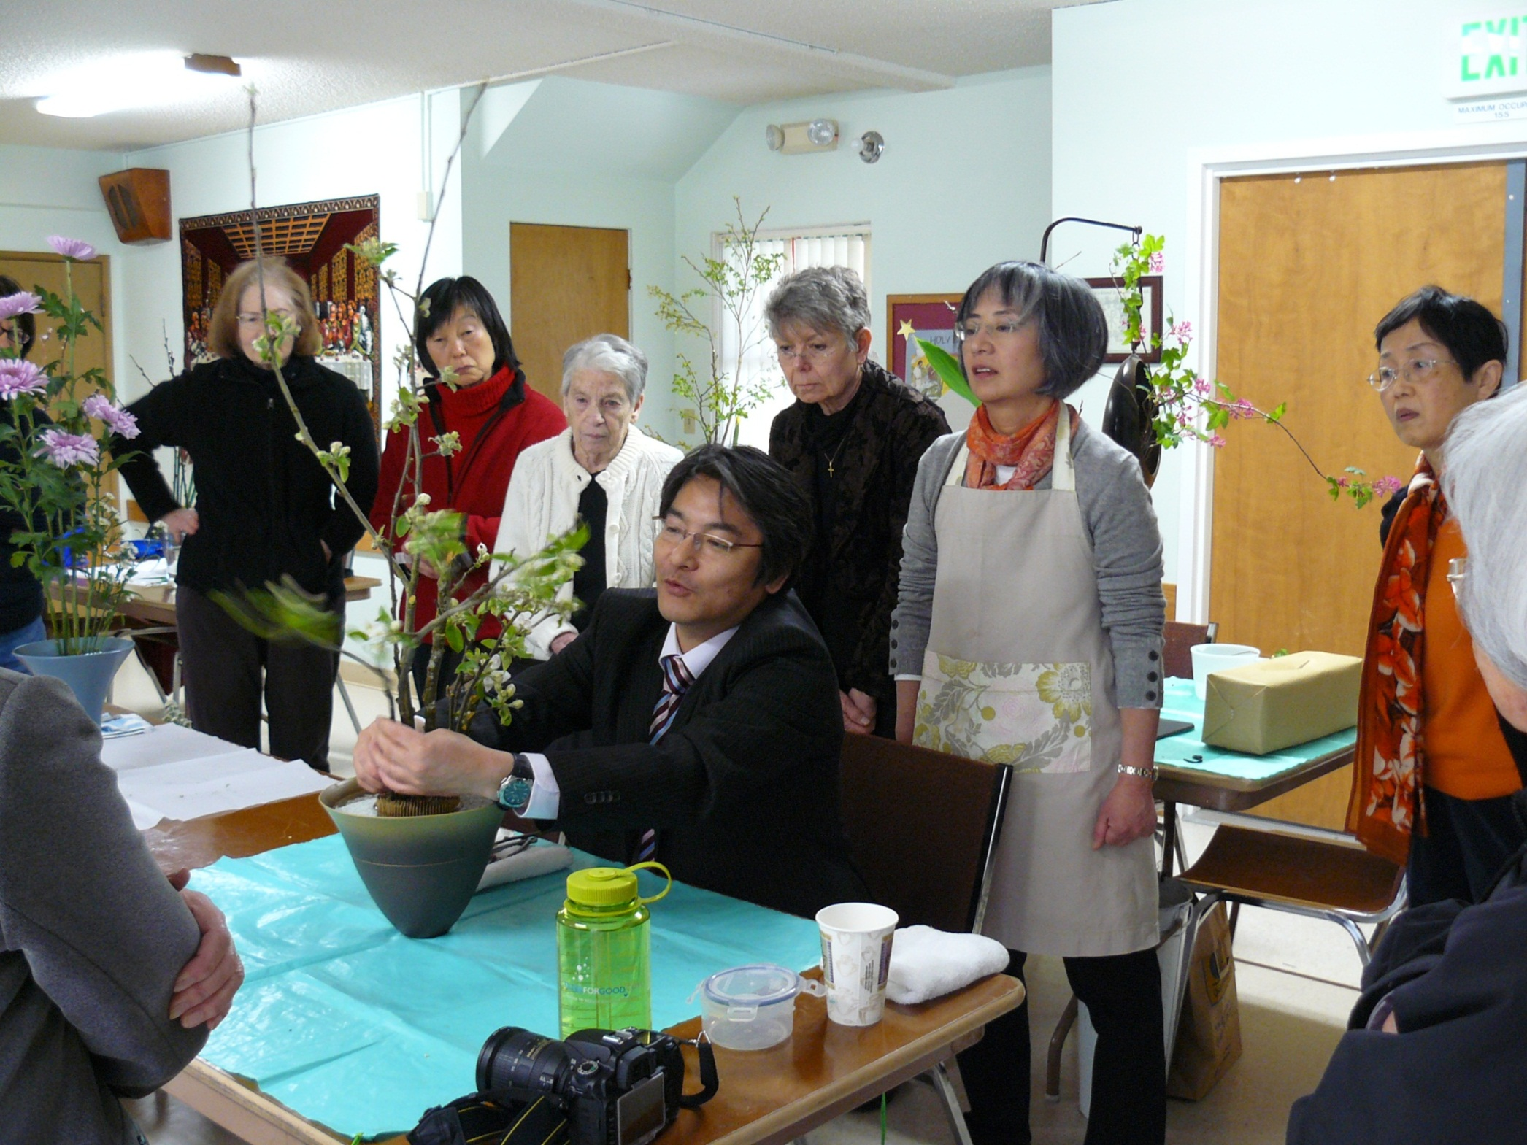

Slide 25
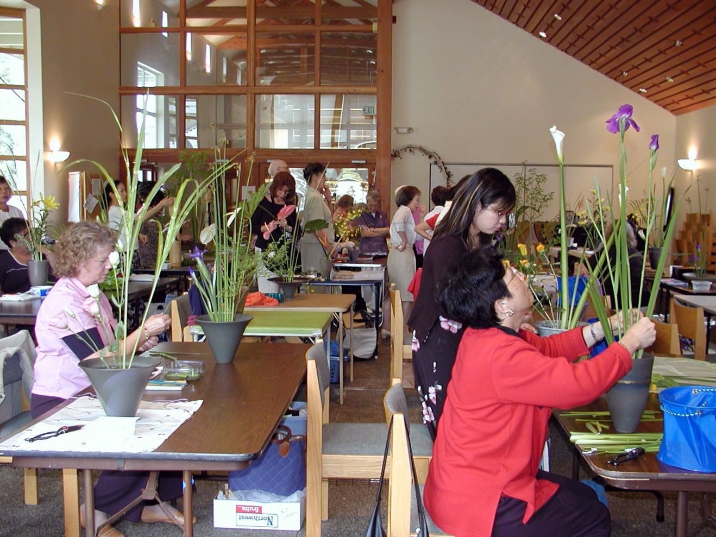

Slide 26
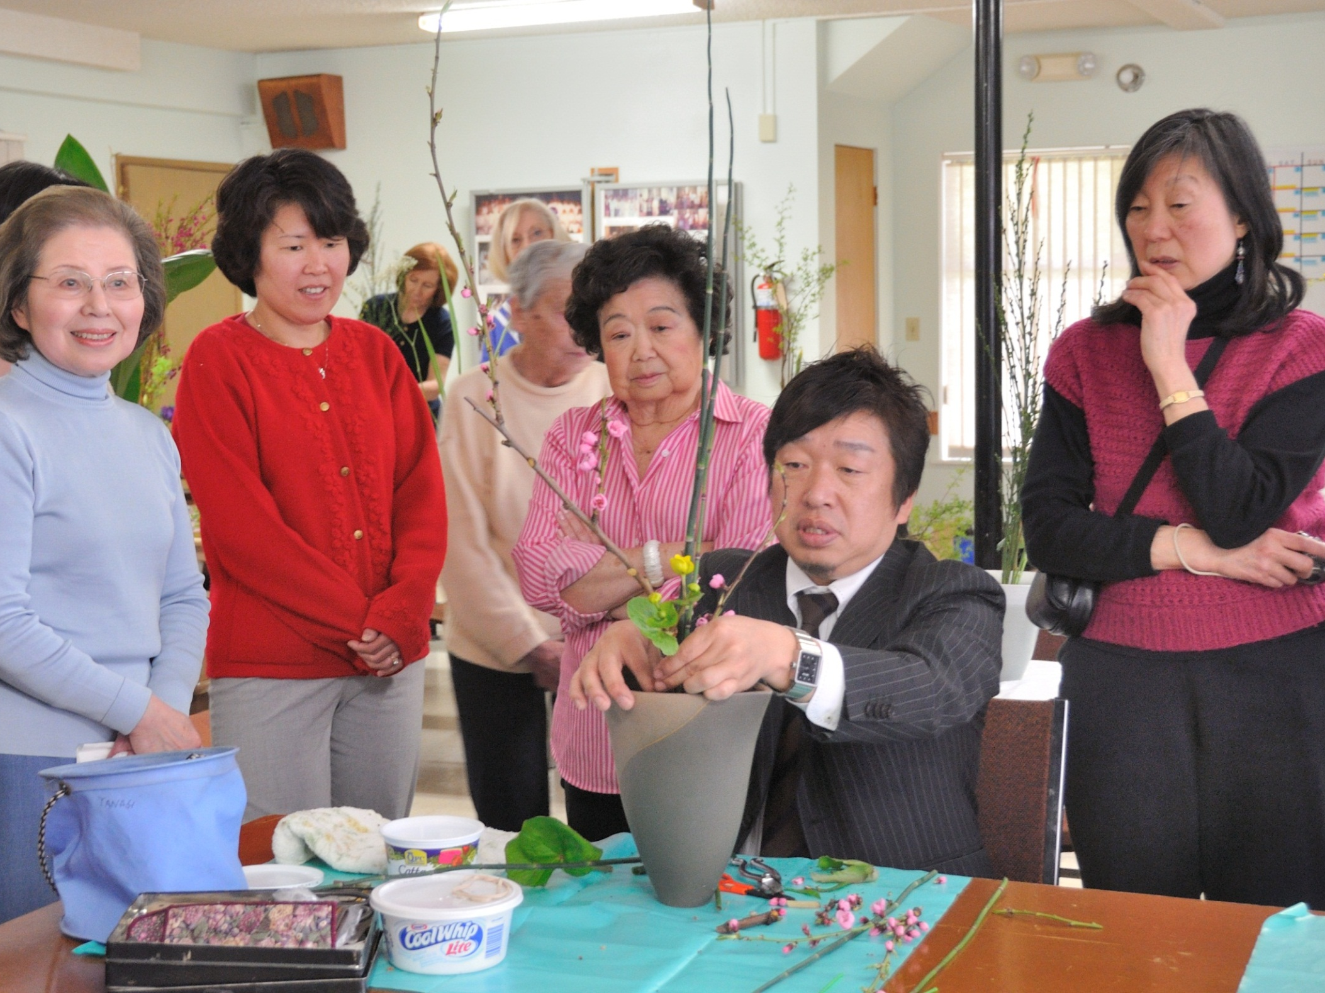

Slide 27
Demonstrations
by
Lake Washington Chapter
Members
生花デモ

Slide 28
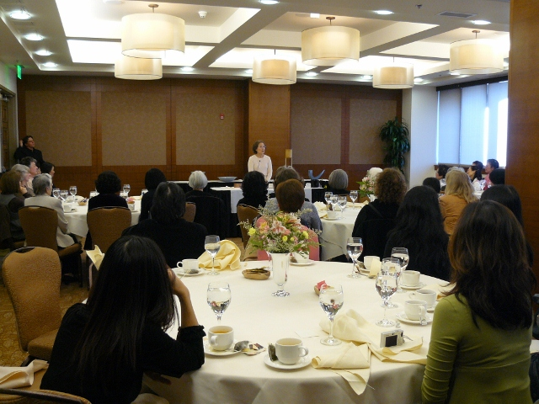
Senior Professor Shigeko Price - 2008

Slide 29
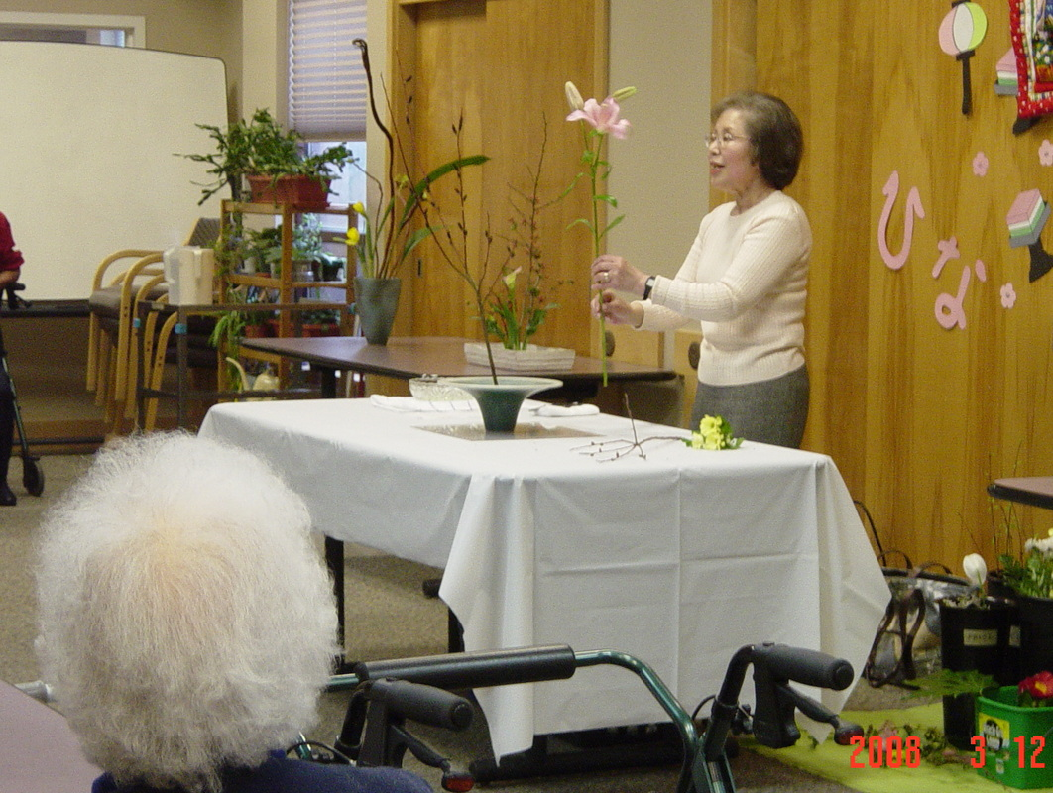
Senior Professor Shigeko Price - 2008

Slide 30
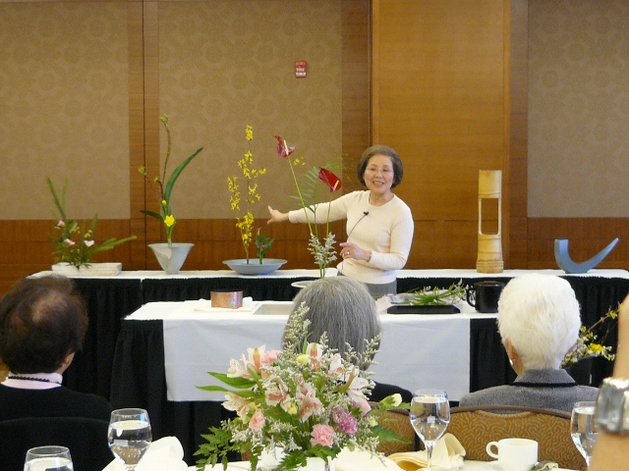
Senior Professor Shigeko Price - 2008

Slide 31
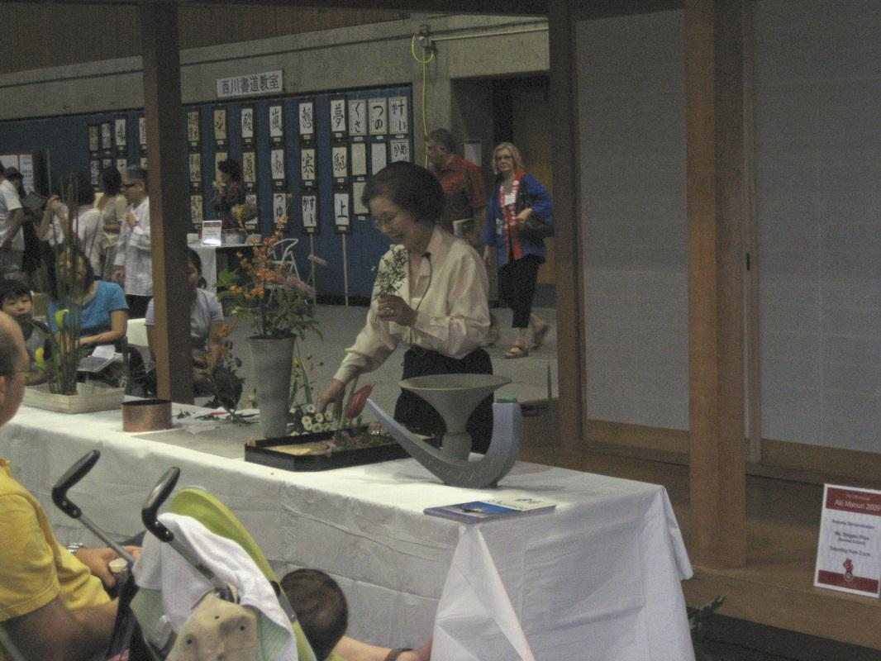
Senior Professor Shigeko Price - 2009

Slide 32
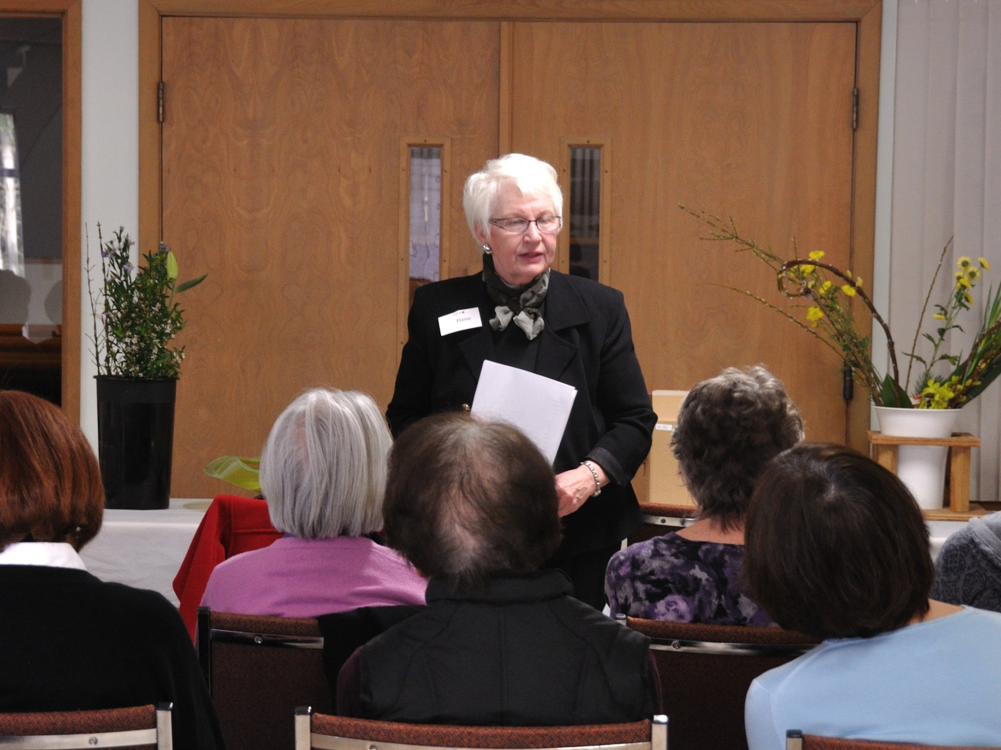
Senior Professor Elaine Stamm 2010

Slide 33
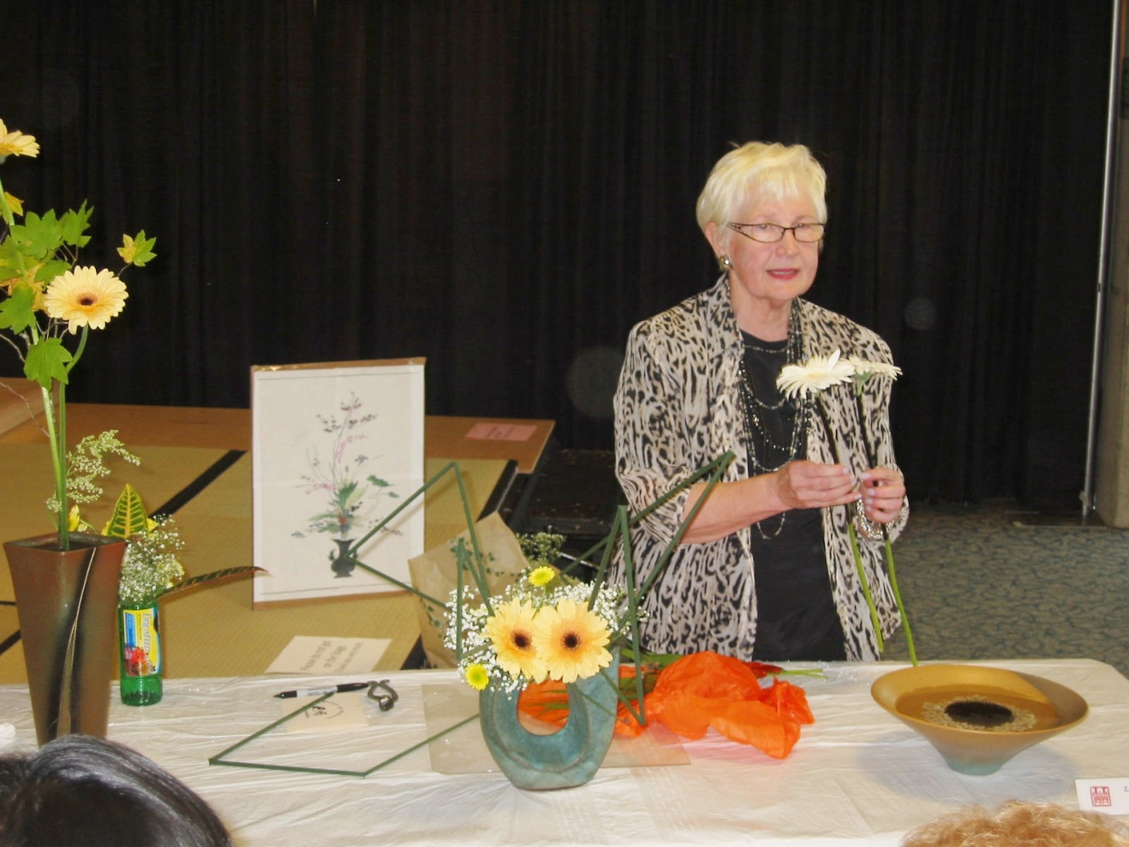
Senior Professor Elaine Stamm - 2011

Slide 34
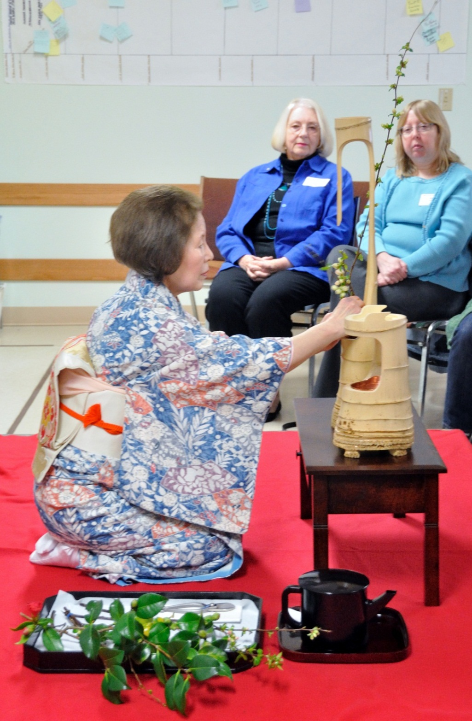
Senior Professor Shigeko Price - 2012

Slide 35
Lake Washington Chapter
Learning Luncheons
支部会員のミーテイング

Slide 36
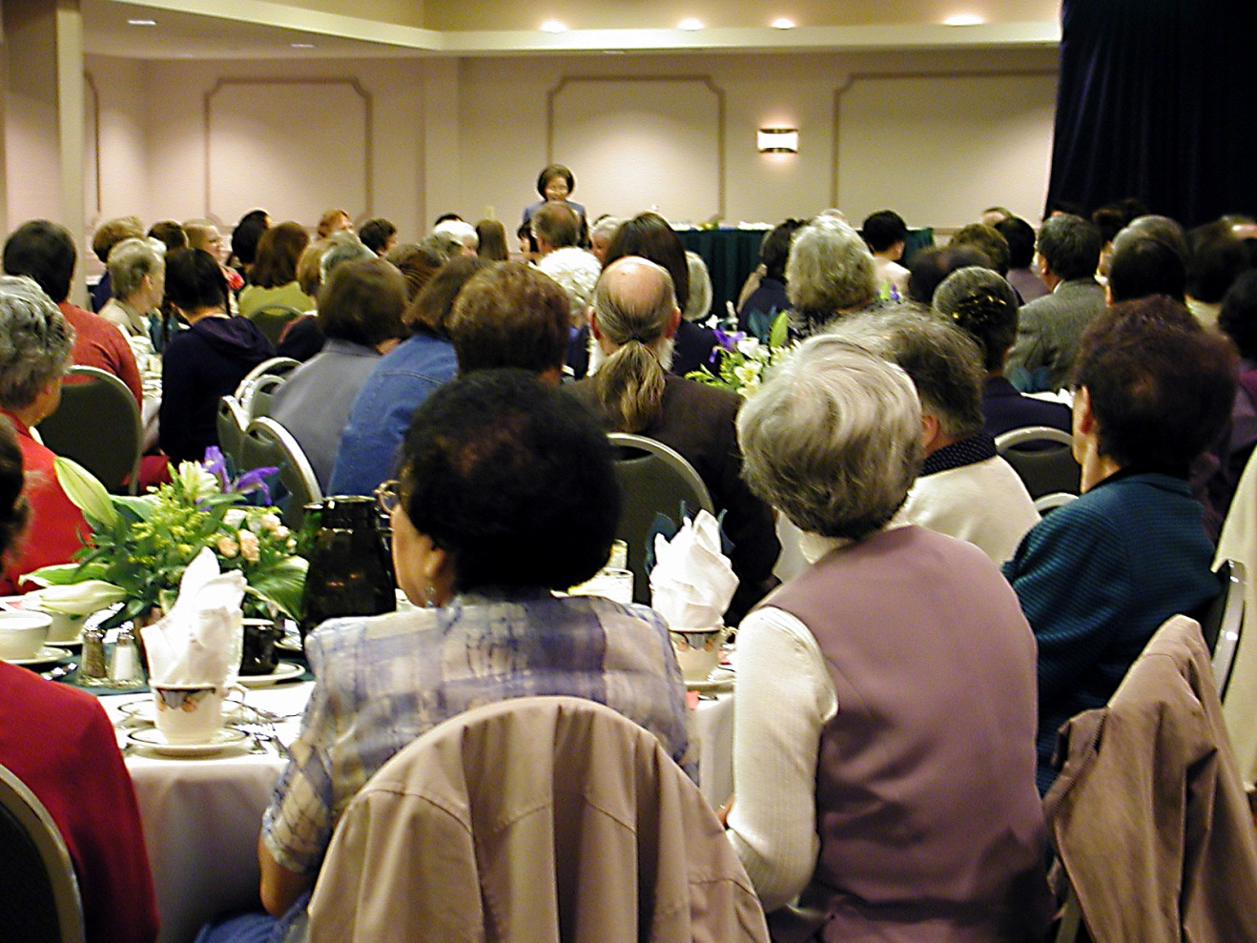
Chapter Founding Celebration Luncheon - 2003

Slide 37
Chapter Luncheon with Demonstration - 2008

Slide 38
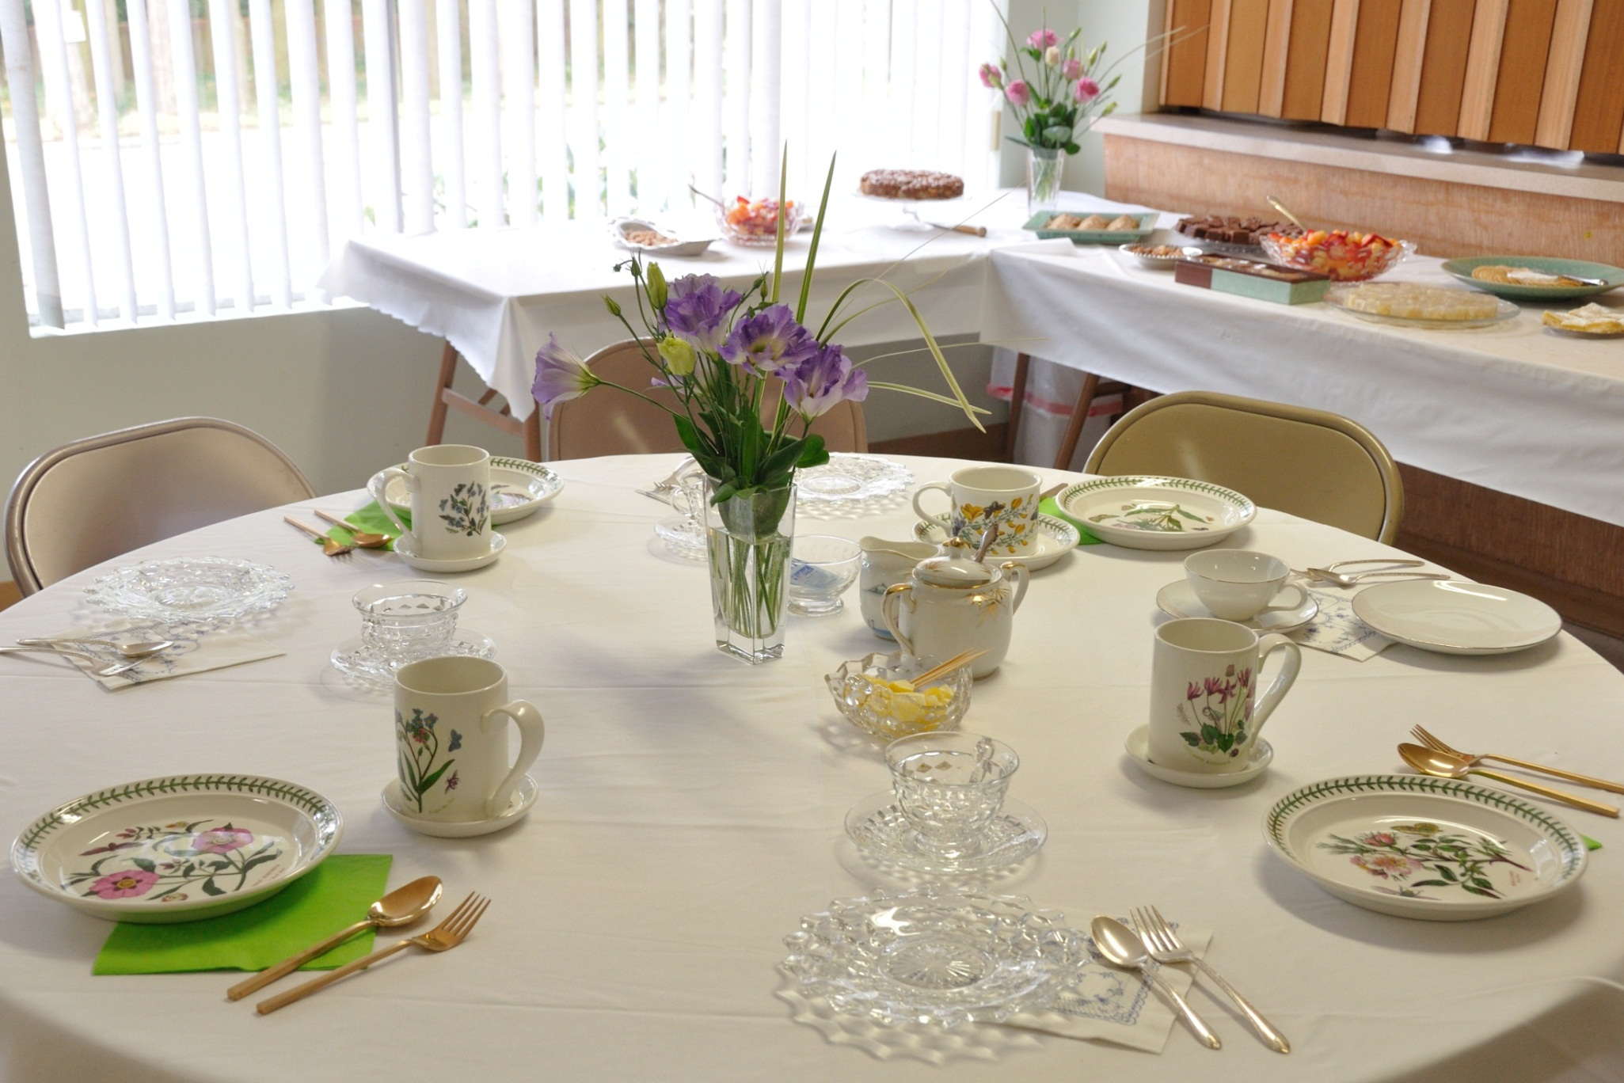
Chapter Tea with demonstration - 2011

Slide 39
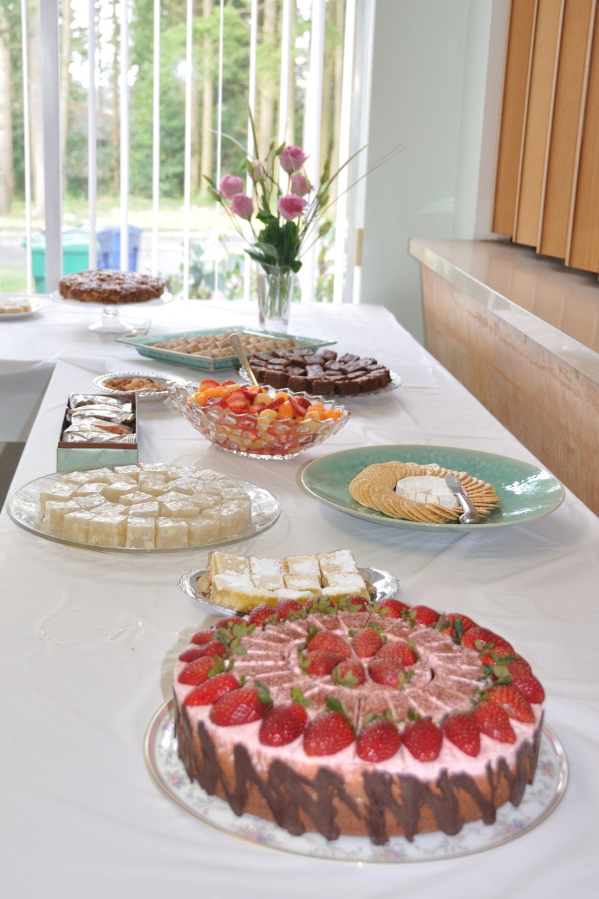
Chapter Tea with demonstration - 2011

Slide 40
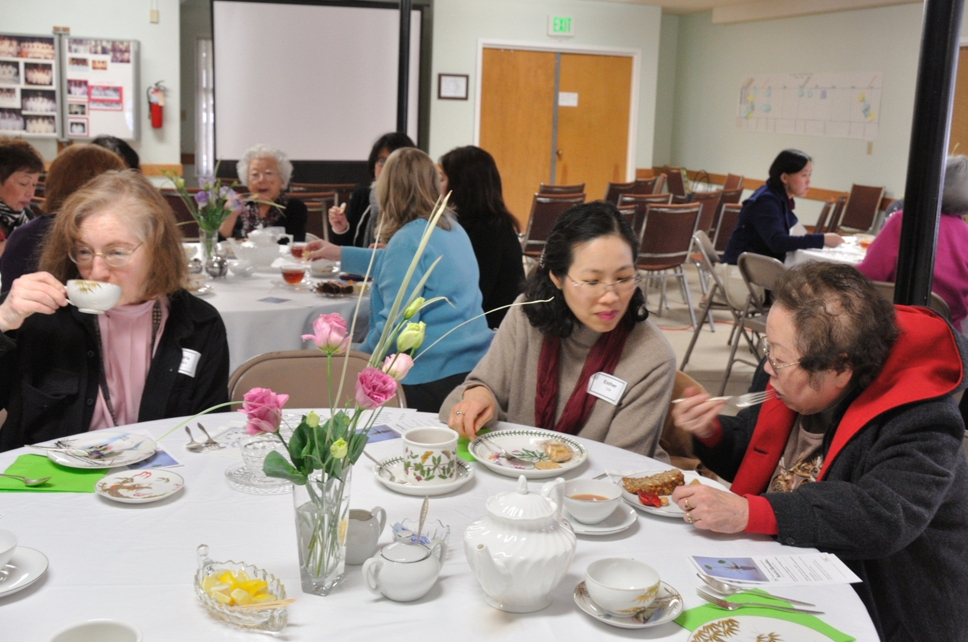
Chapter Tea with demonstration - 2011

Slide 41
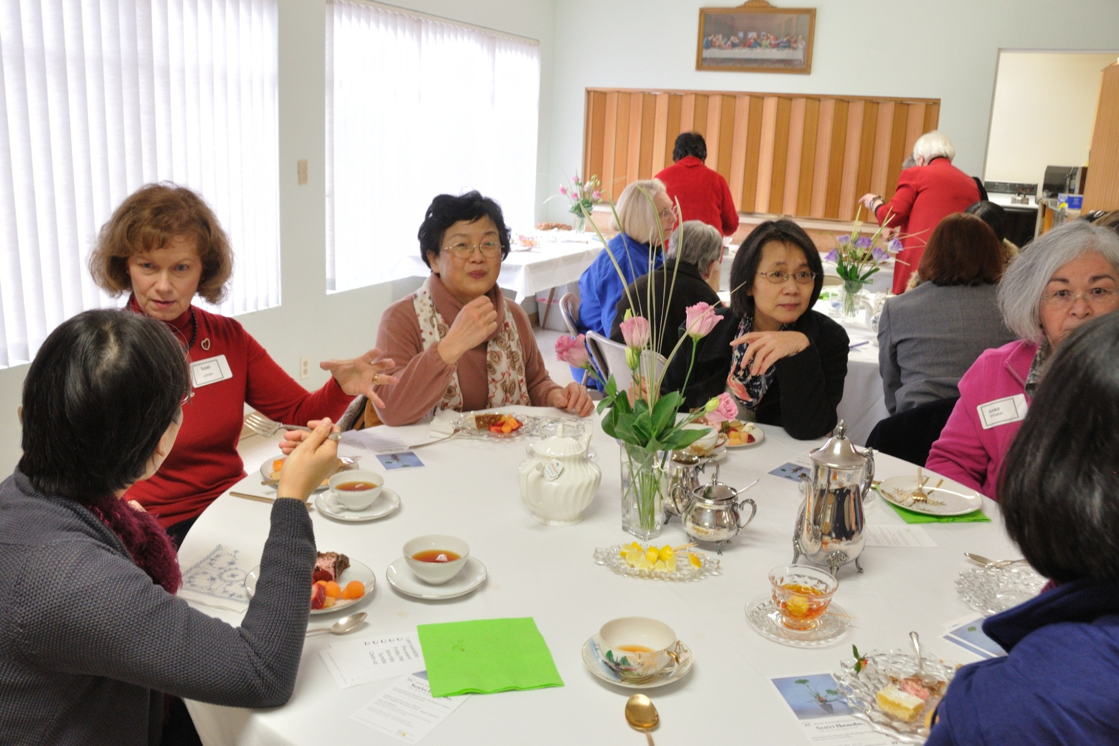
Chapter Tea with demonstration - 2011

Slide 42
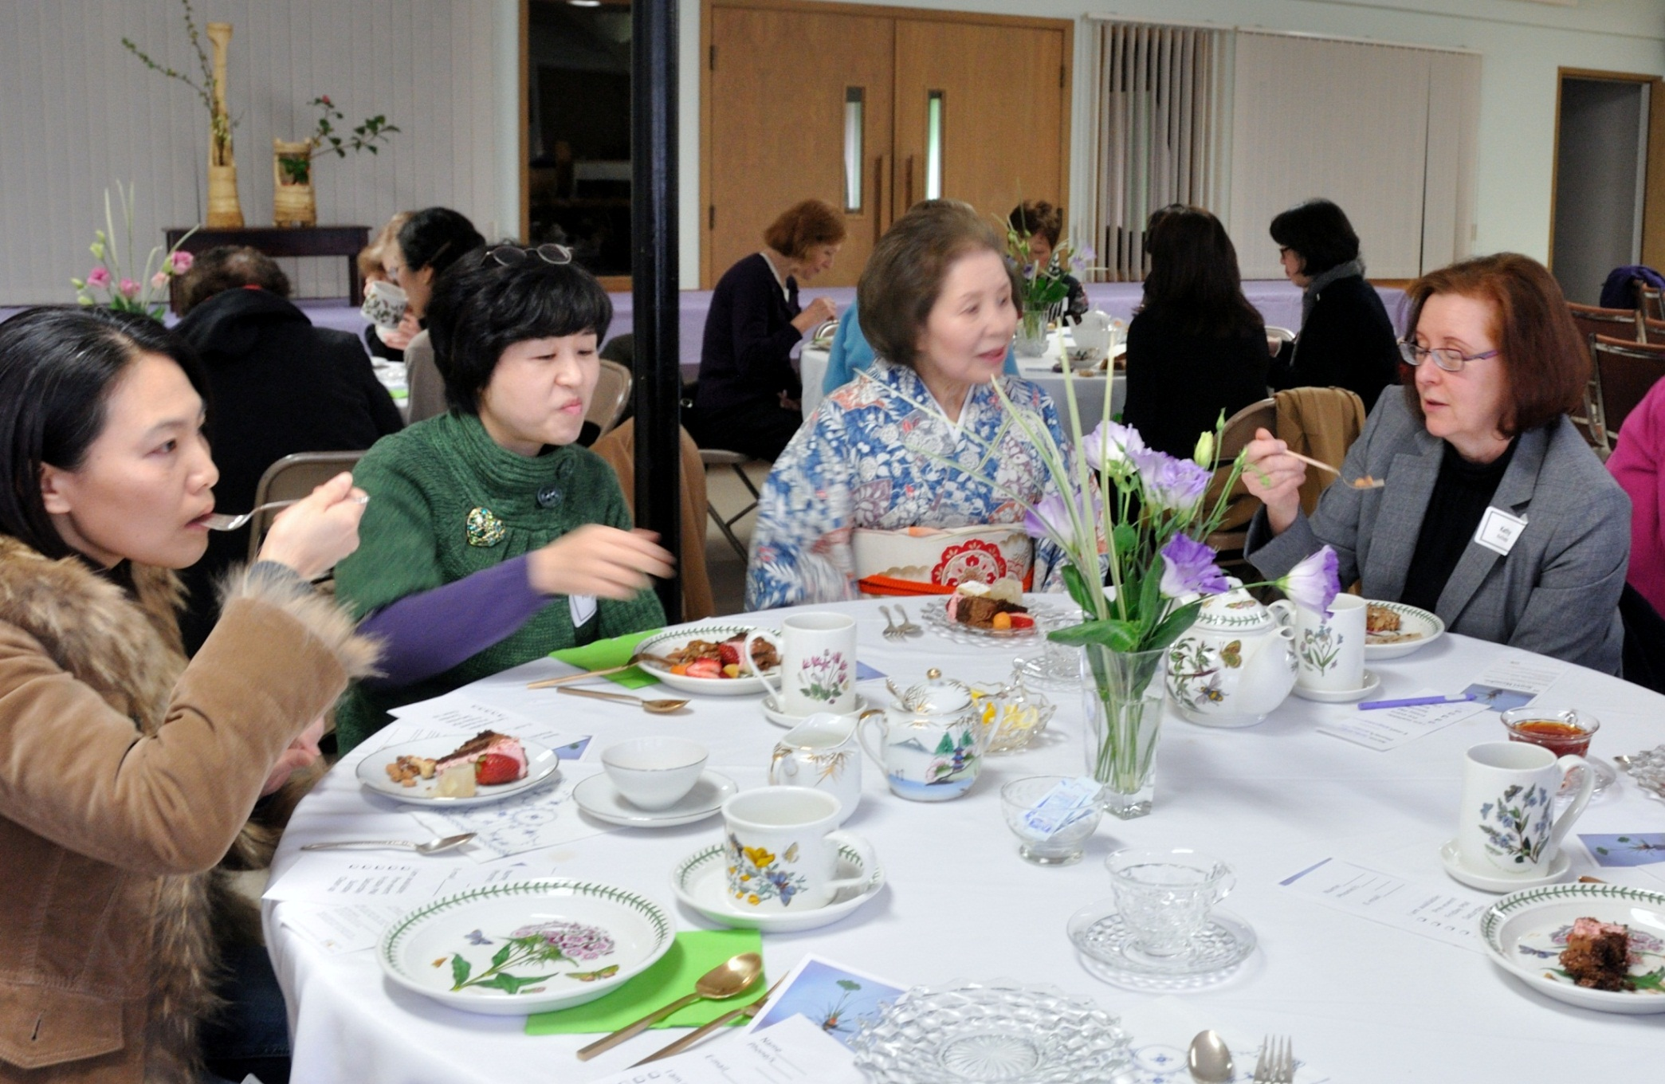
Chapter Tea with demonstration - 2012

Slide 43
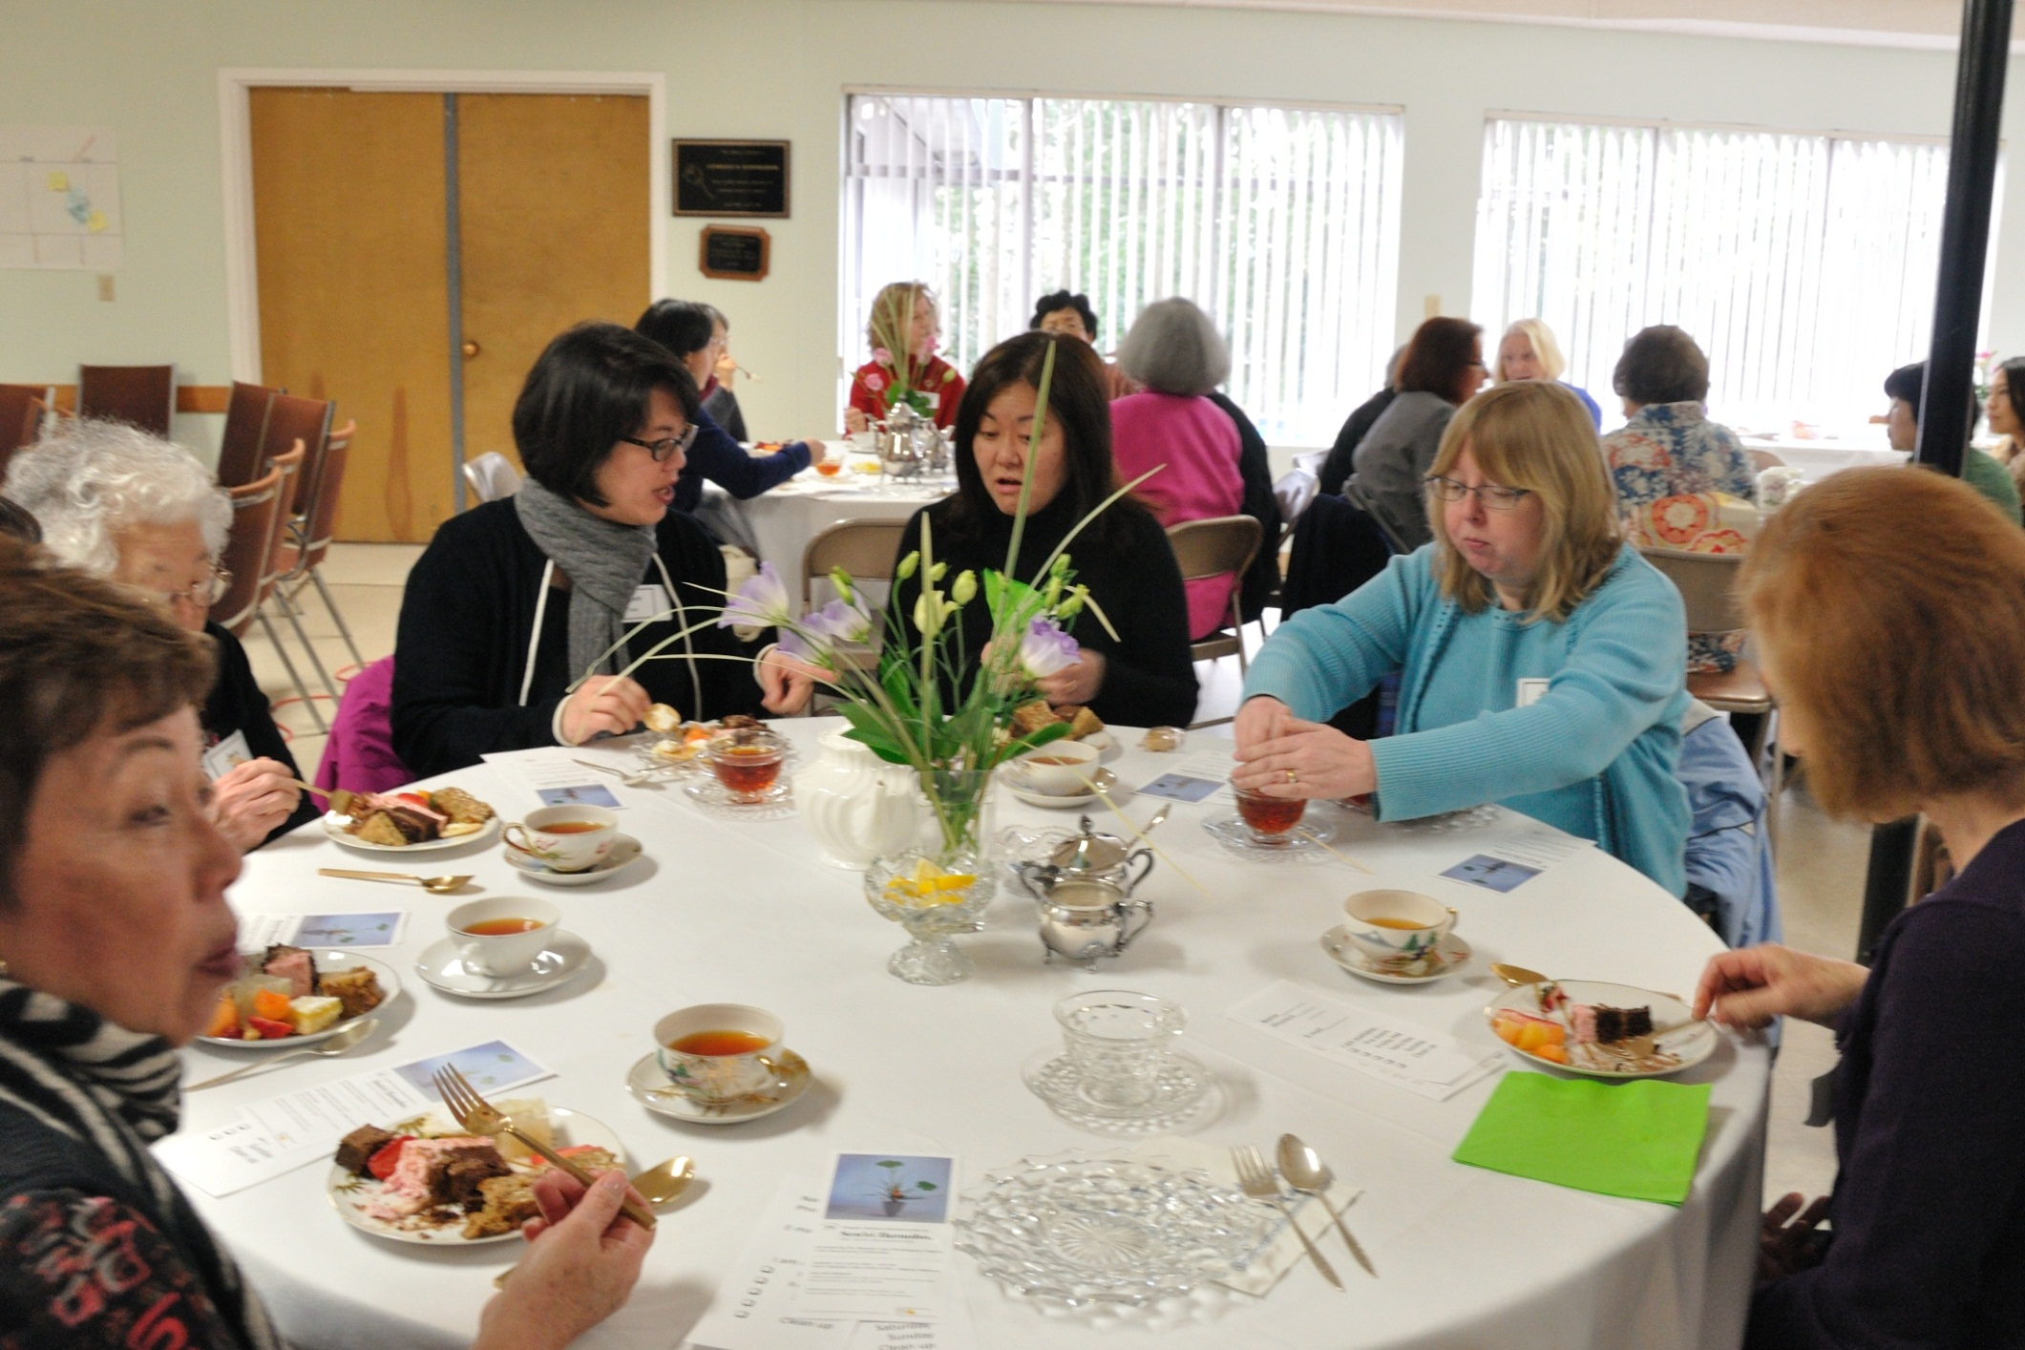
Chapter Tea with demonstration - 2012

Slide 44
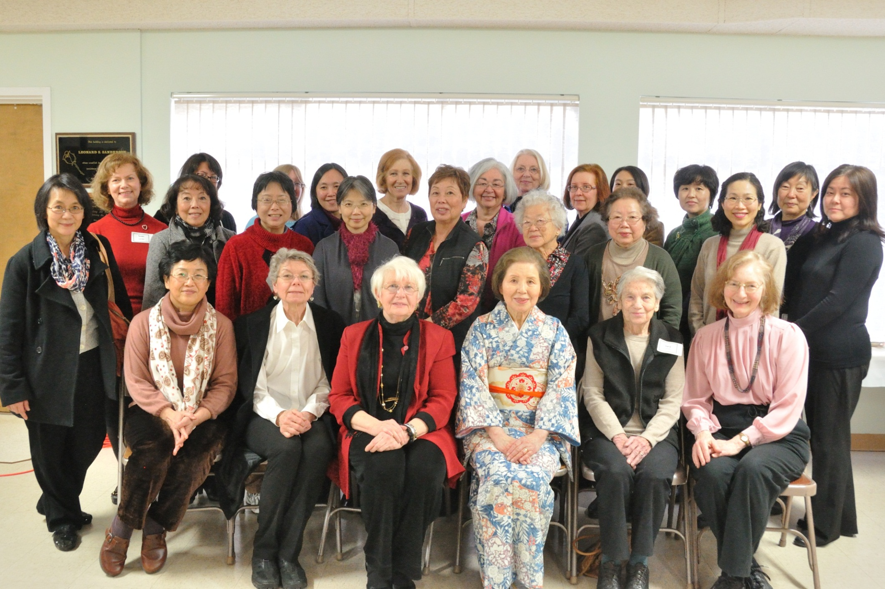
Chapter Tea with demonstration - 2012

Slide 45
Special Visiting Professors who conducted our
Lake Washington Chapter
Workshops
支部創立後の特別派遣講師

Slide 46
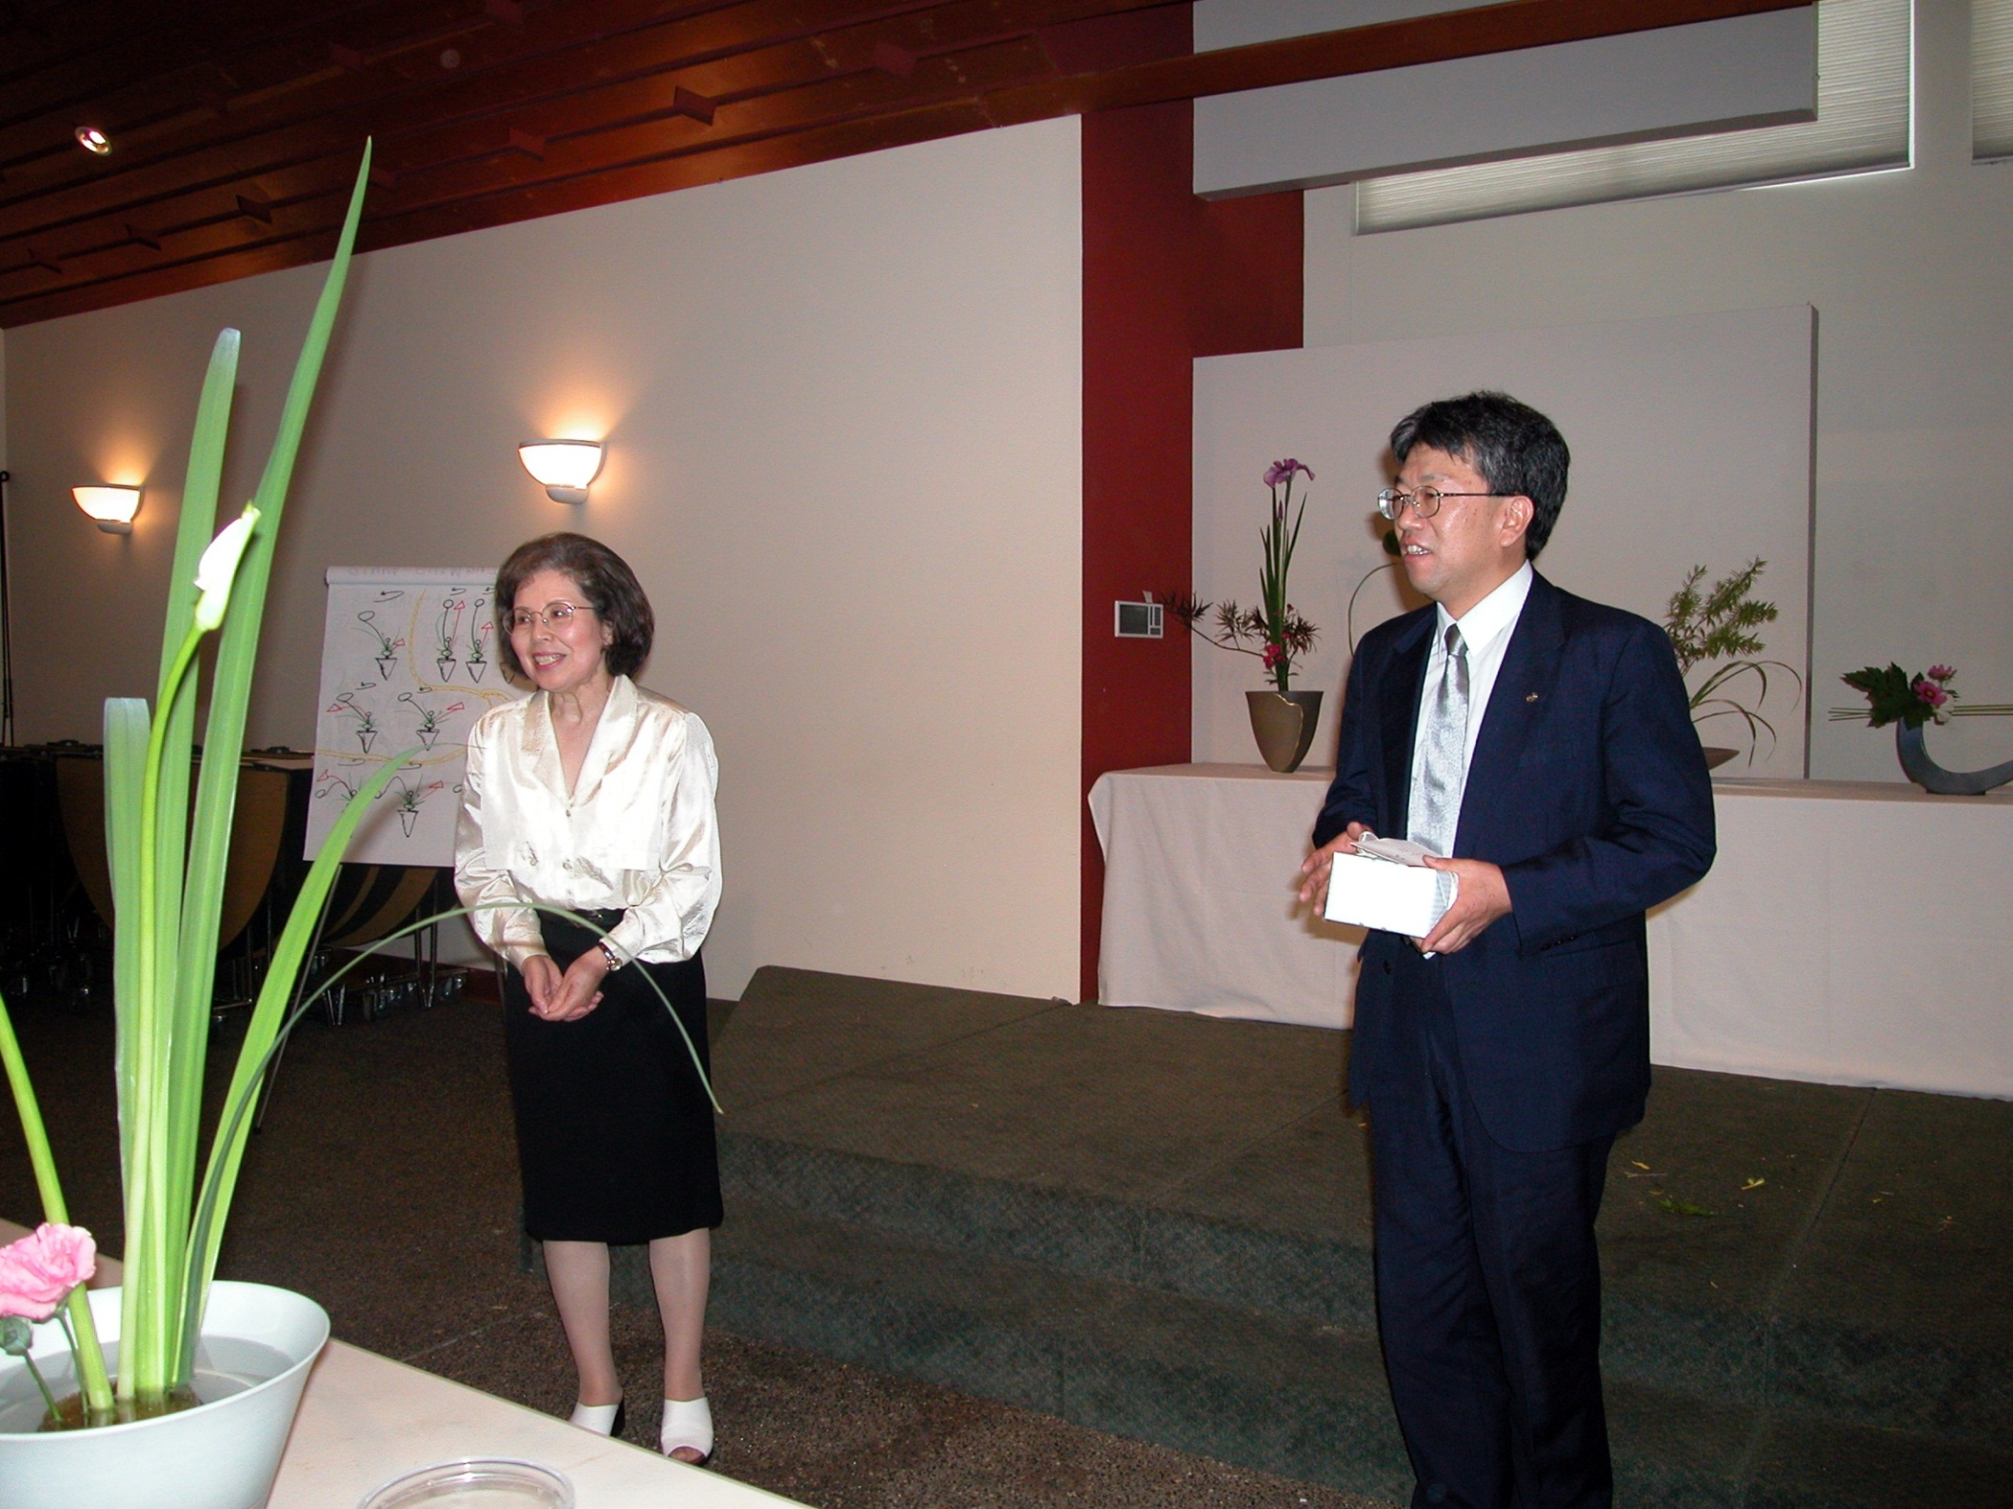
Special Visiting Professor Kanrai Iguchi 2002
特別派遣講師 井口先生

Slide 47
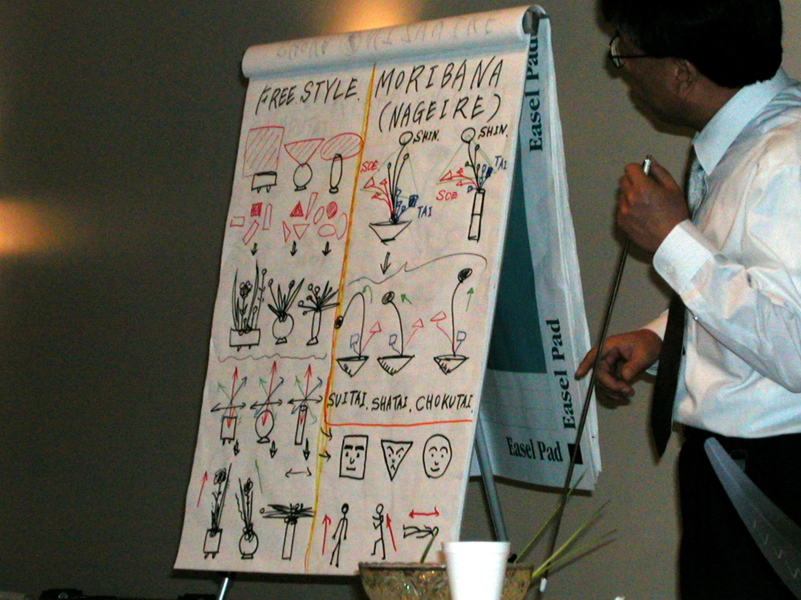
Special Visiting Professor Kanrai Iguchi 2002
特別派遣講師 井口先生

Slide 48
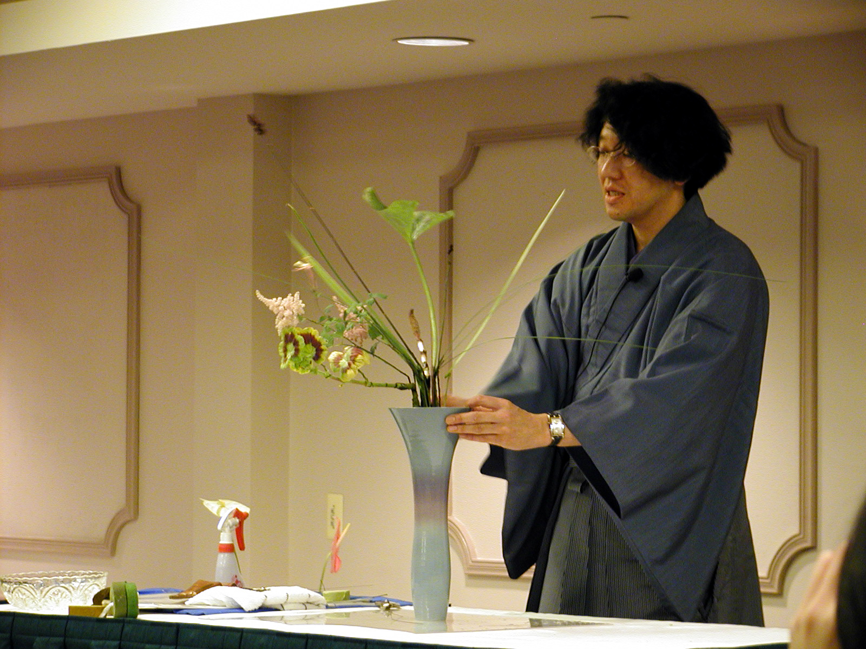
Special Visiting Professor Yasuhito Sasaki – 2003
特別派遣講師 佐々木 先生

Slide 49
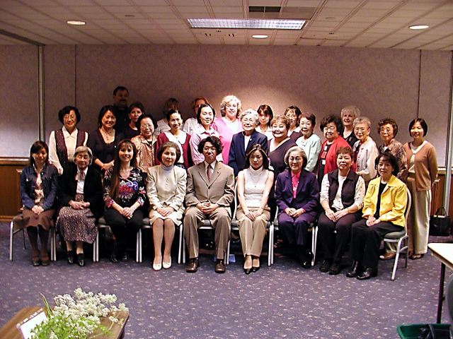
Special Visiting Professor Yasuhito Sasaki – 2003
特別派遣講師 佐々木 先生

Slide 50
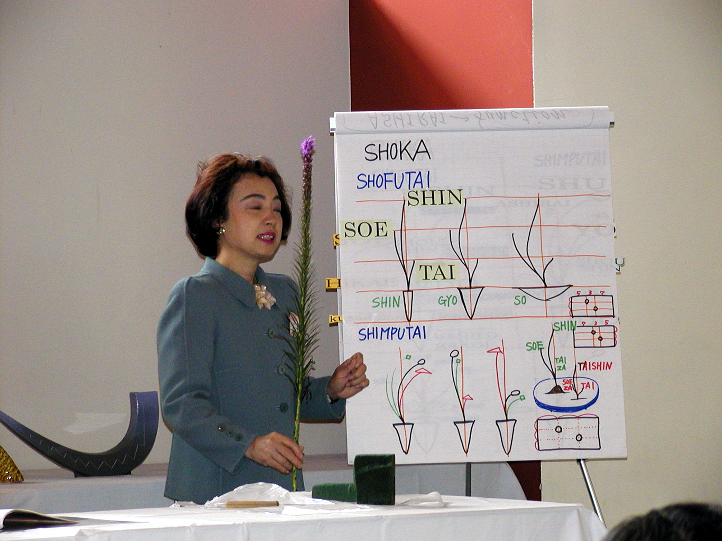
Special Visiting Professor Yoshiko Kobayashi – 2004
特別派遣講師 小林 先生

Slide 51
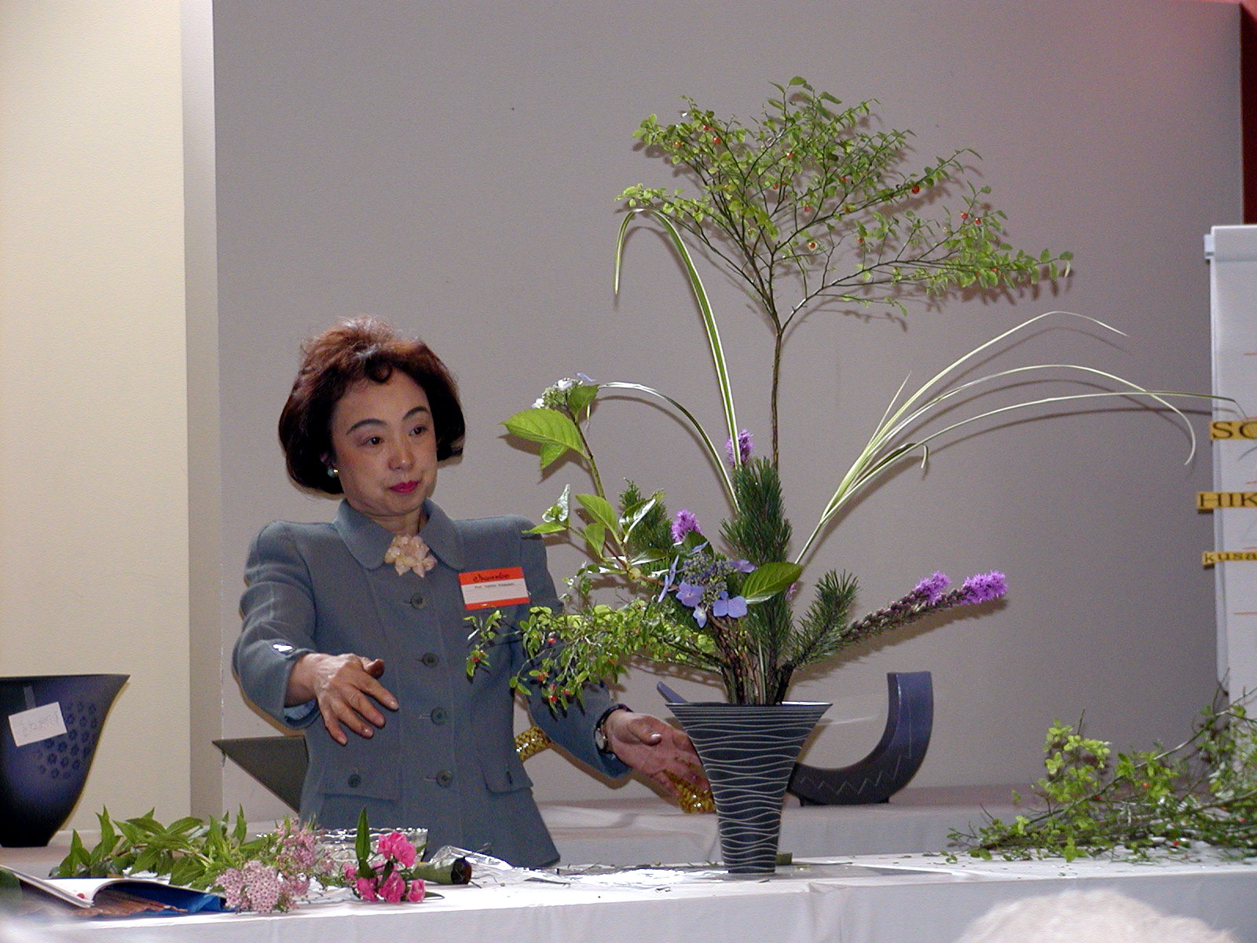
Special Visiting Professor Yoshiko Kobayashi – 2004
特別派遣講師 小林 先生

Slide 52
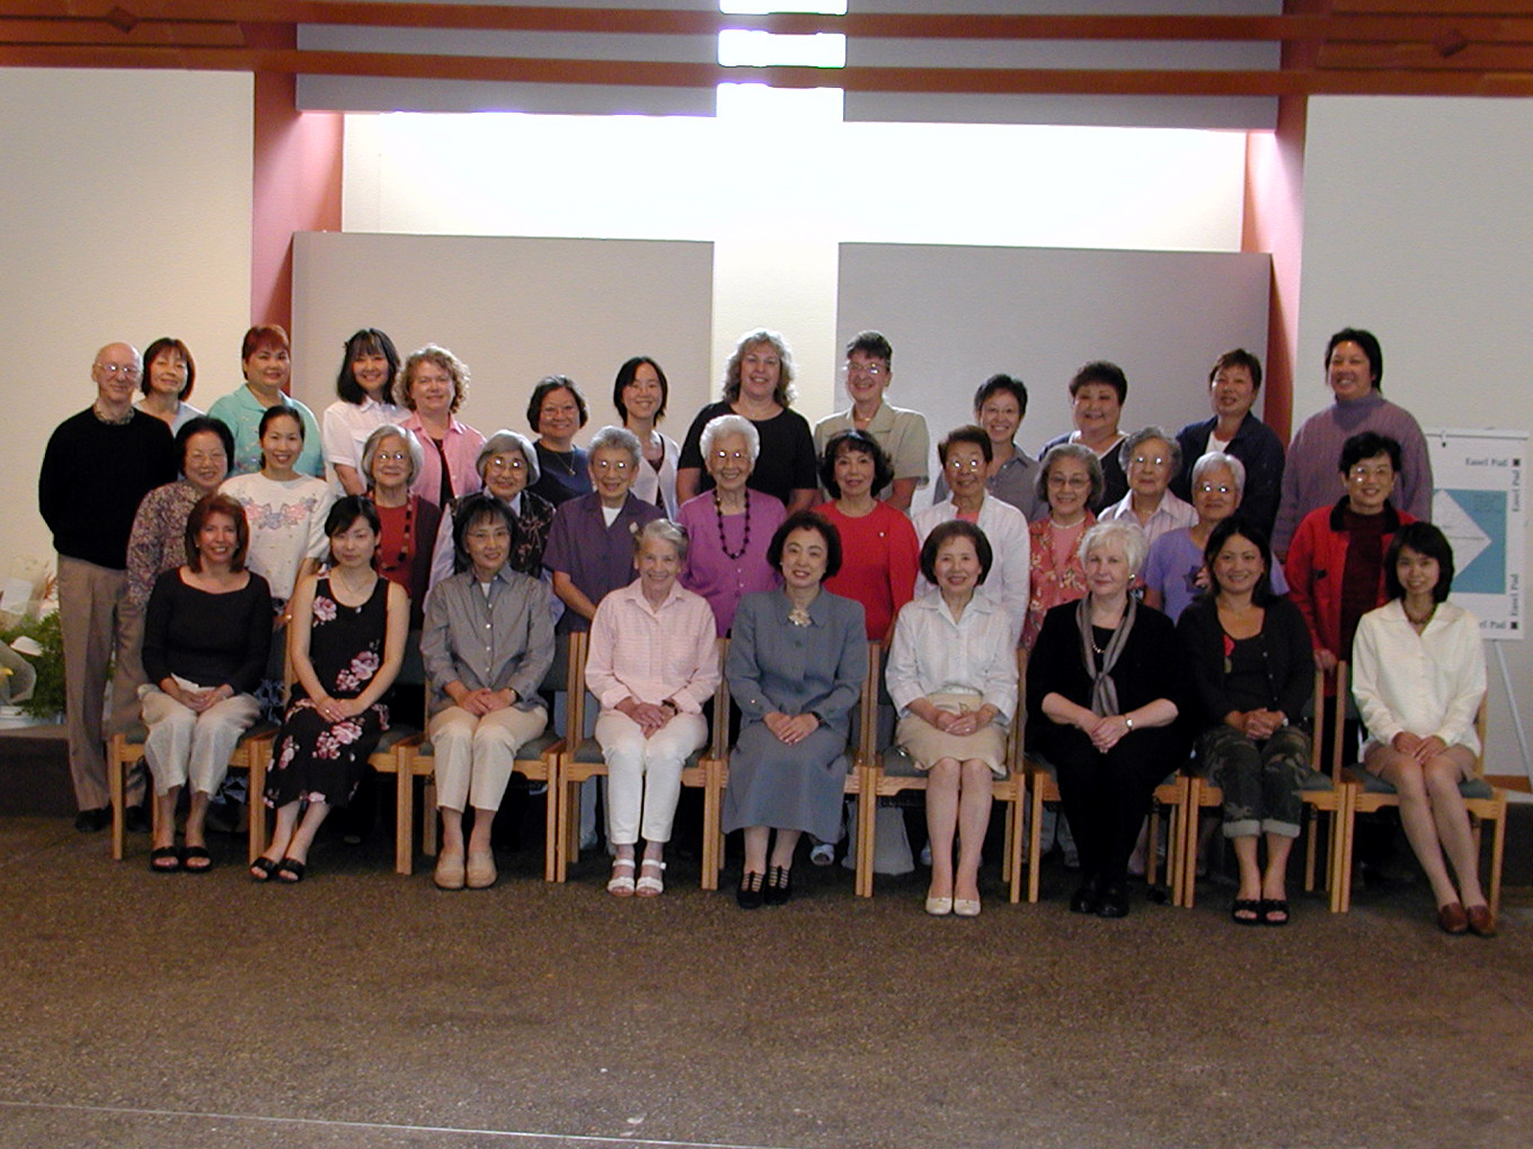
Special Visiting Professor Yoshiko Kobayashi – 2004
特別派遣講師 小林 先生

Slide 53
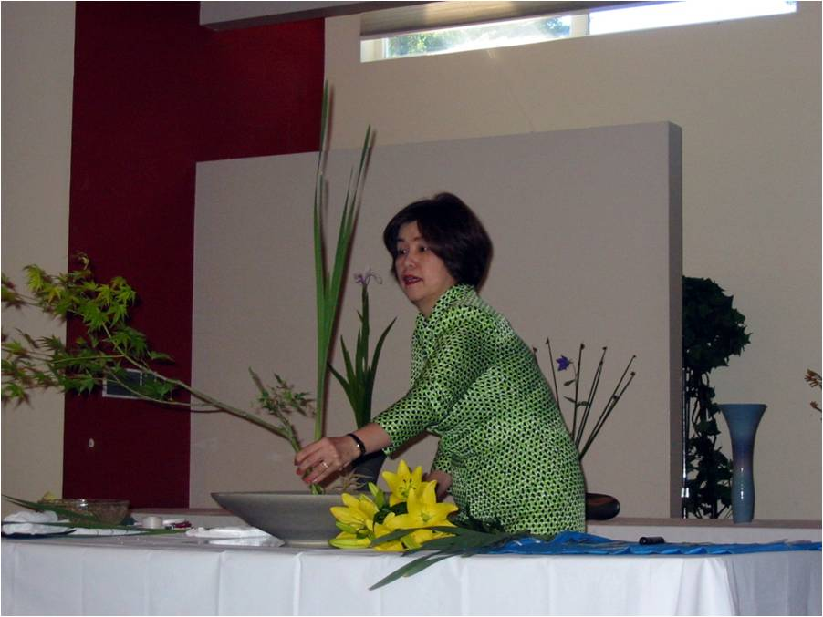
Special Visiting Professor Keiko Hori – 2005
特別派遣講師 堀 先生

Slide 54
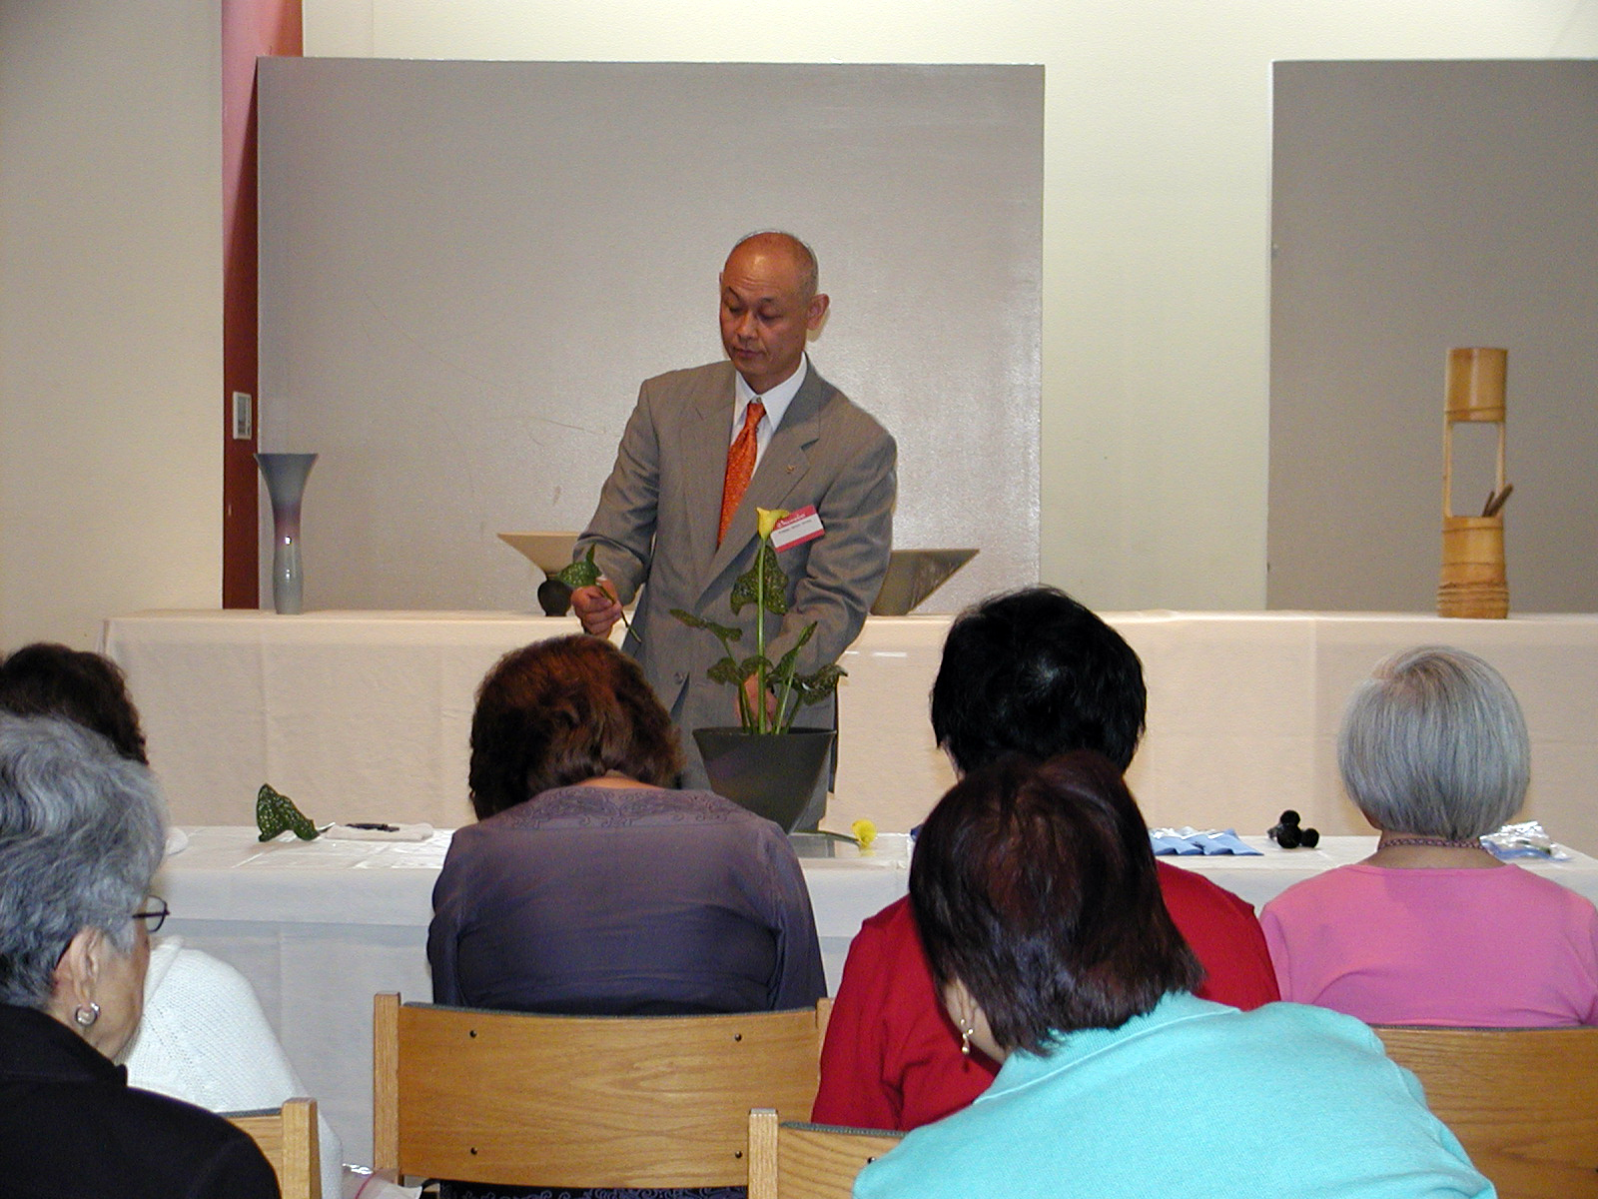
Special Visiting Professor Shinichi Shimizu – 2006
特別派遣講師 清水 先生

Slide 55
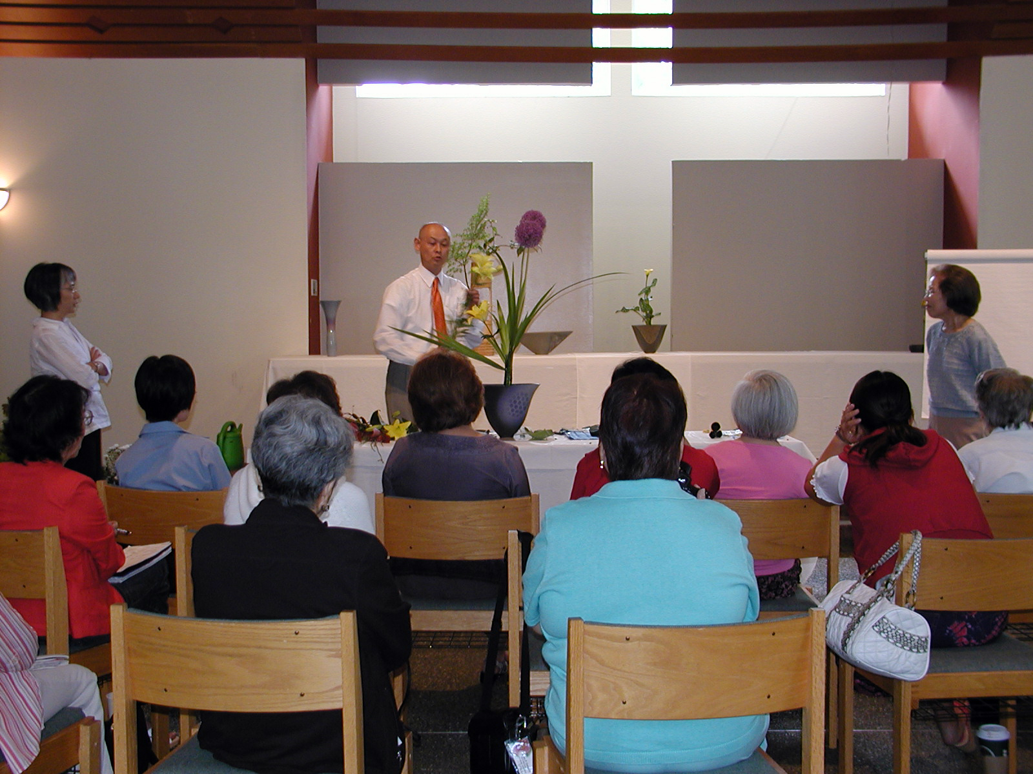
Special Visiting Professor Shinichi Shimizu – 2006
特別派遣講師 清水 先生

Slide 56
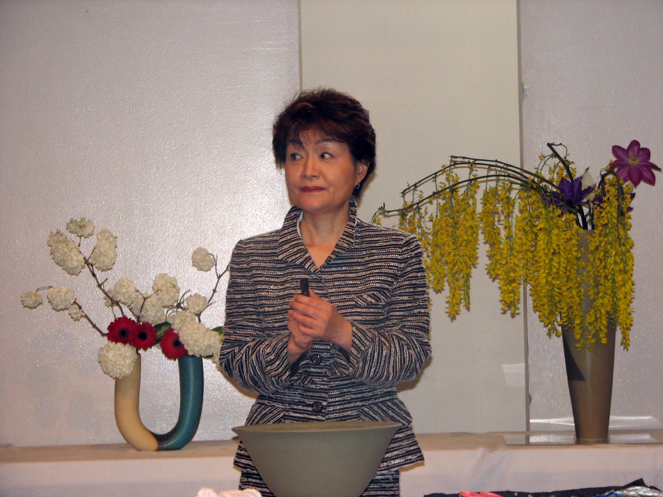
Special Visiting Professor Mitsuko Kato – 2007
特別派遣講師 加藤 先生

Slide 57
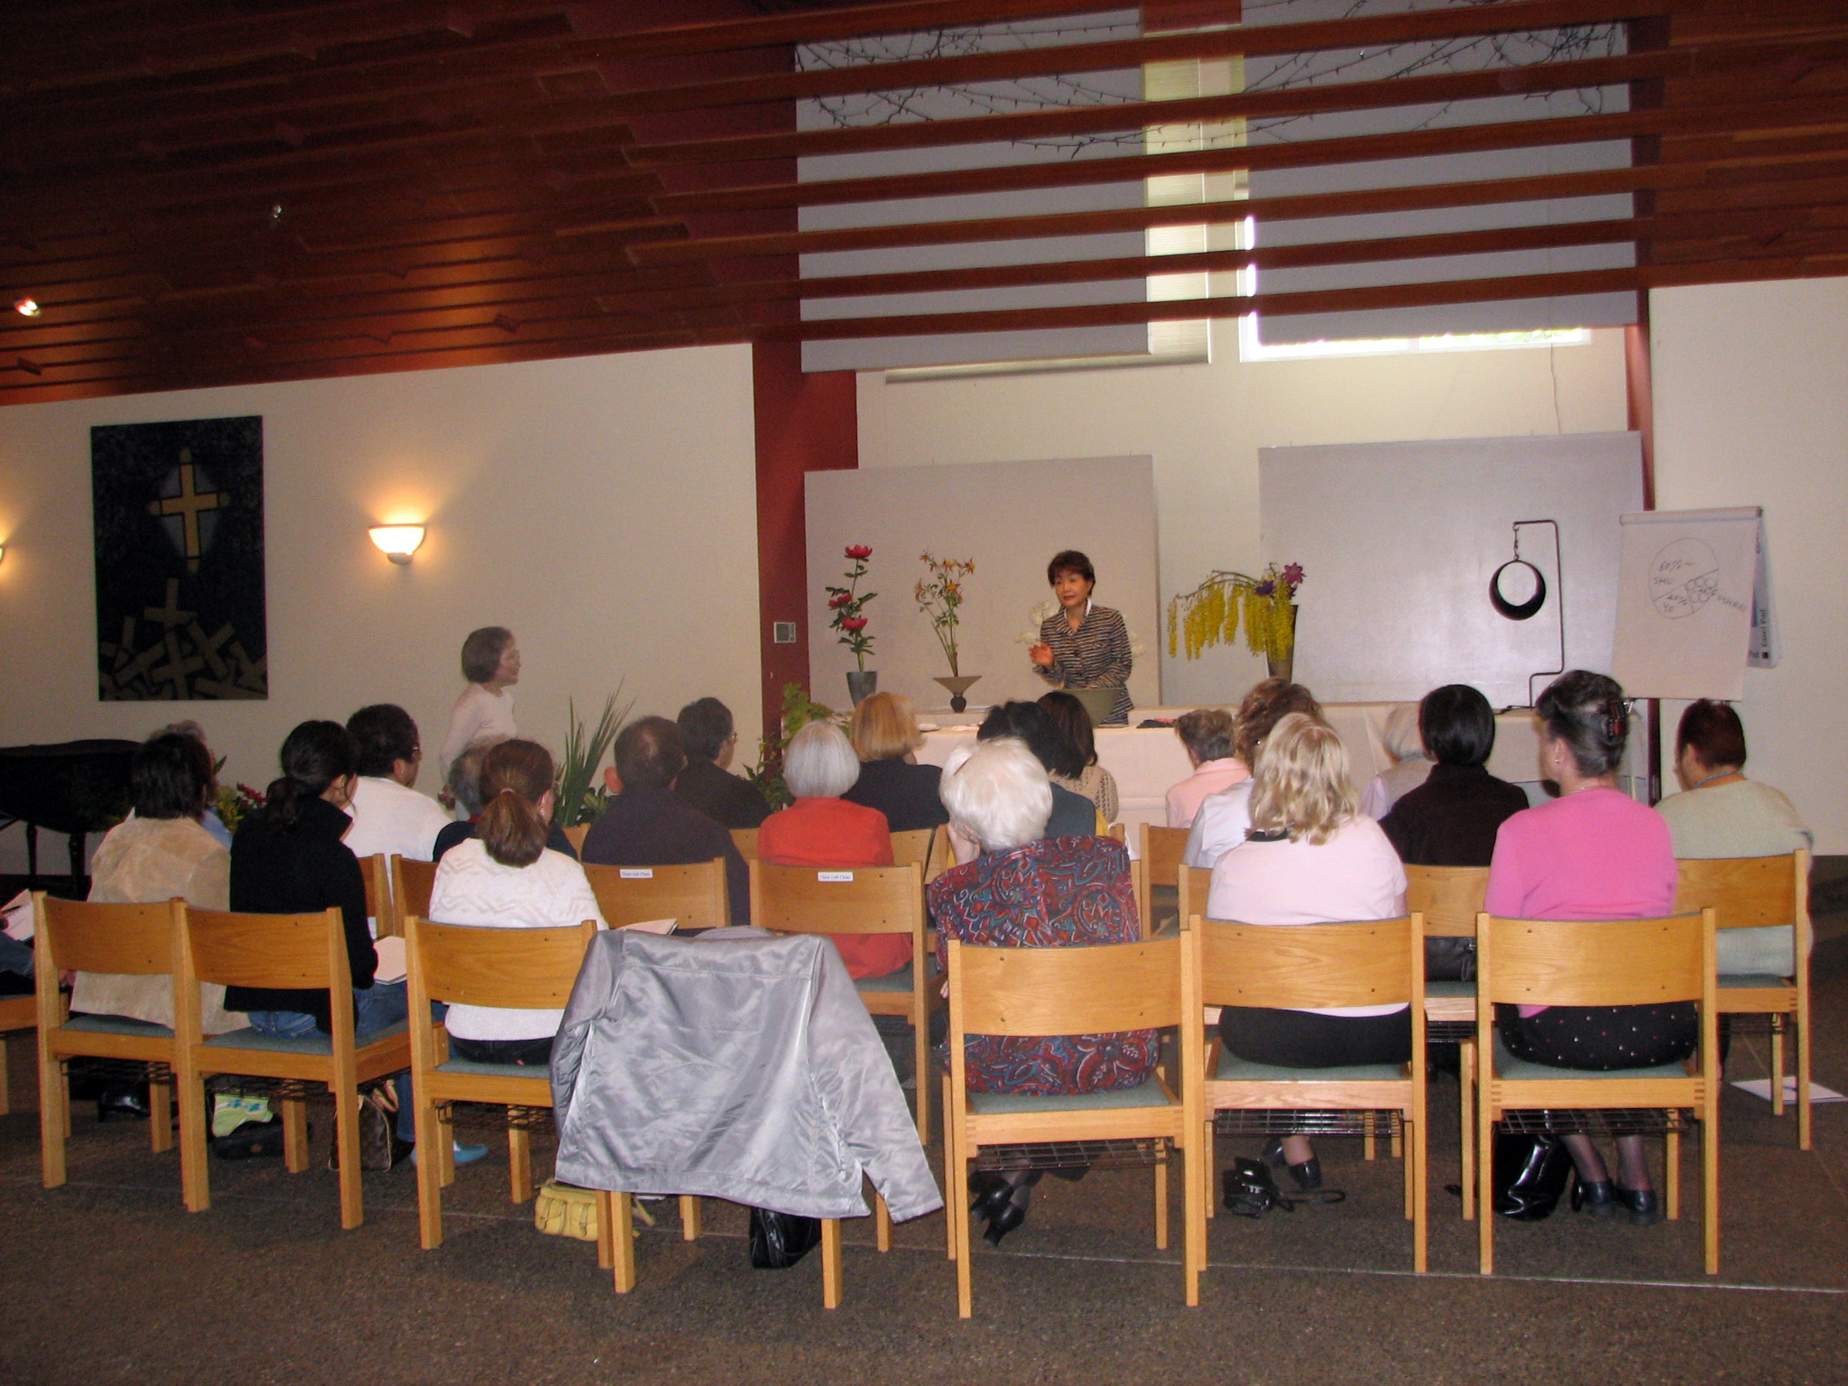
Special Visiting Professor Mitsuko Kato – 2007
特別派遣講師 加藤 先生

Slide 58
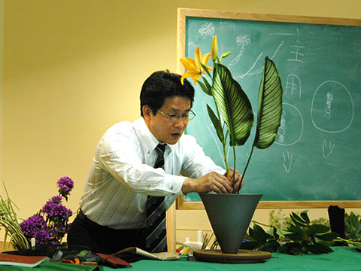
Special Visiting Professor Mitsumasa Toyoda – 2008
特別派遣講師 豊田 先生

Slide 59

Special Visiting Professor Noriko Obata – 2009
特別派遣講師 小幡 先生

Slide 60

Special Visiting Professor Kuniyoshi Tsuchiya – 2010
特別派遣講師 土屋 先生

Slide 61

Special Visiting Professor Hirotaka Furukawa – 2011
特別派遣講師 古川 先生

Slide 62

Special Visiting Professor Hirotaka Furukawa – 2011
特別派遣講師 古川 先生

