Slide 1
Lake Washington Chapter
10 Anniversary Celebration
Ribbon Cutting and Exhibition

Slide 2
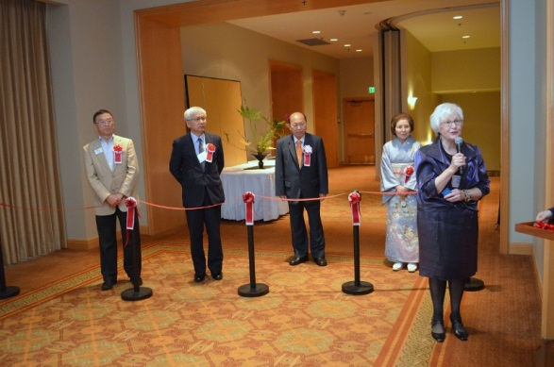
Chapter Vice President and Celebration Committee Chair Elaine Stamm introduces honored guest

Slide 3
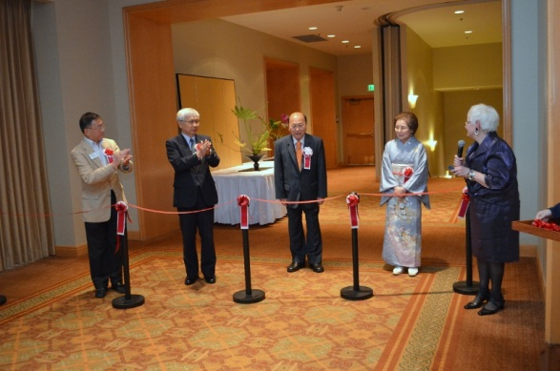
45th Headmaster Sen’ei Ikenobo is introduced

Slide 4
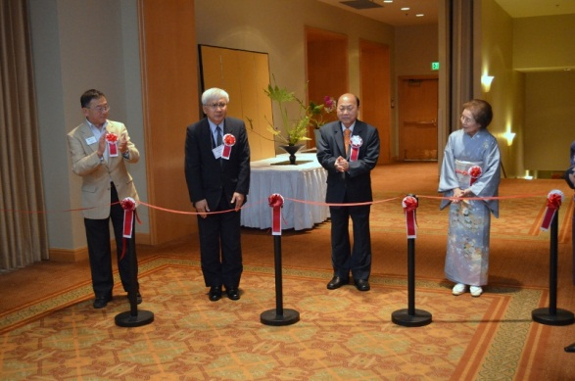
Consul General of Japan-Seattle Kiyokazu Ota is introduced

Slide 5
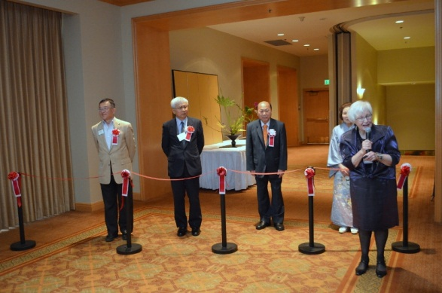
Bellevue WA Mayor Conrad Lee is introduced

Slide 6
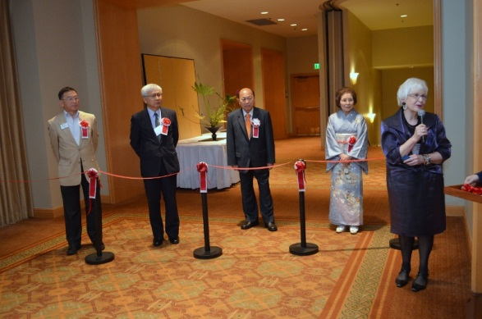
Chapter President Shigeko Price is introduced

Slide 7
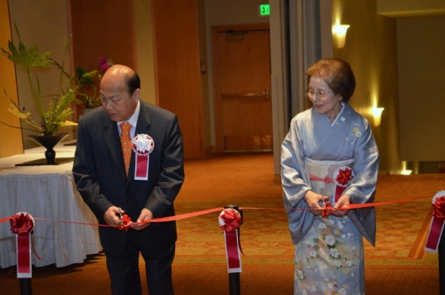
The ribbon cutting begins

Slide 8
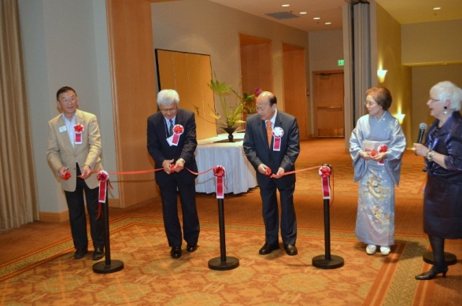
The ribbon cutting finishes

Slide 9
Lake Washington Chapter
10th Anniversary Celebration Exhibition

Slide 10
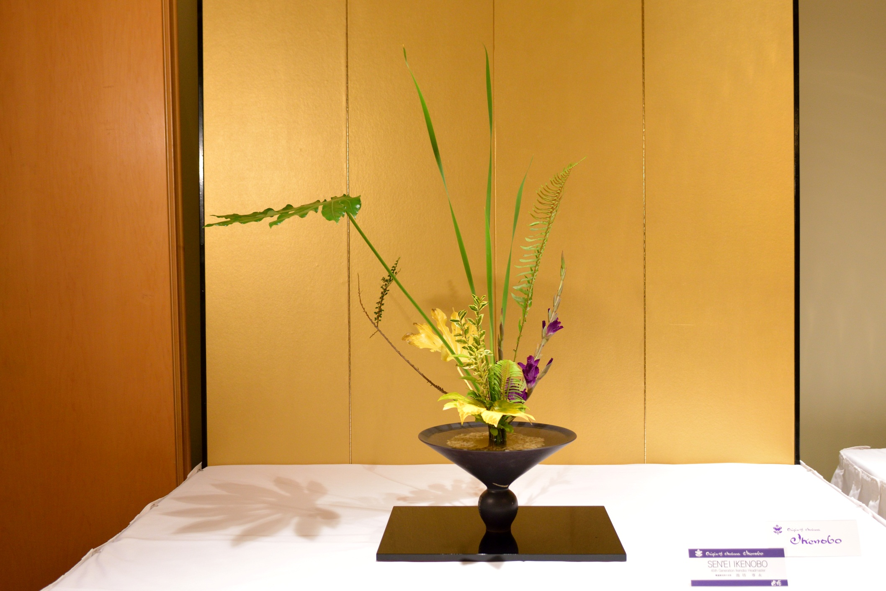
Rikka Shimputai by Headmaster Sen’ei Ikenobo

Slide 11
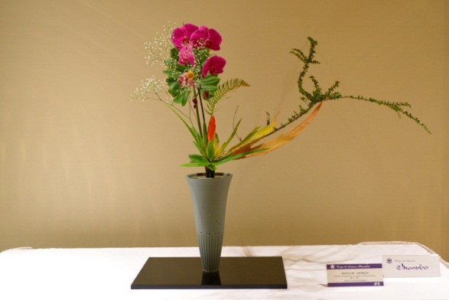
Rikka Shimputai by Professor Shinichi Shimizu

Slide 12
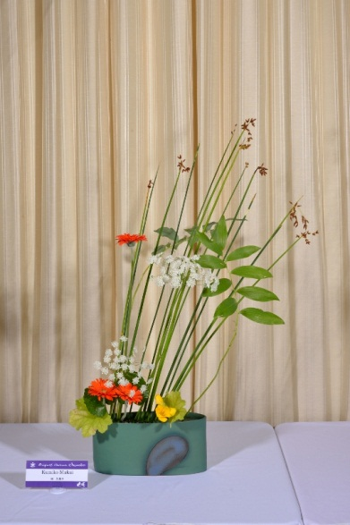
Freestyle by Kumiko Mukai

Slide 13
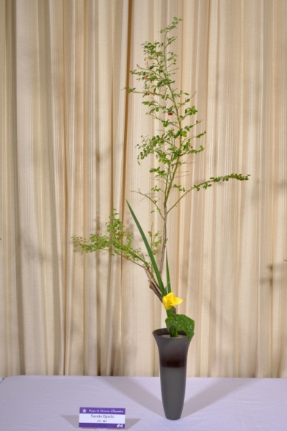
Shoka Shofutai Yasuko Eguchi

Slide 14
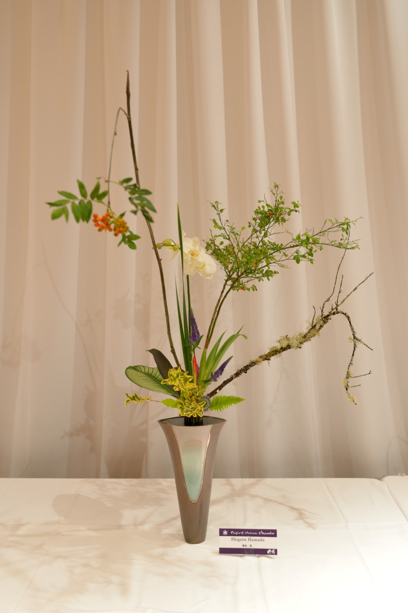
Rikka Shimputai by Shigeru Hamada

Slide 15
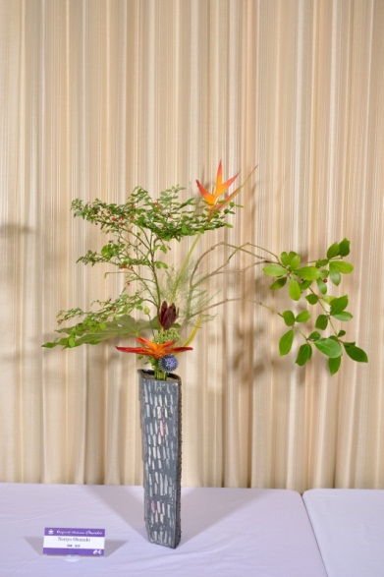
Rikka Shimputai by Noriyo Okazaki

Slide 16
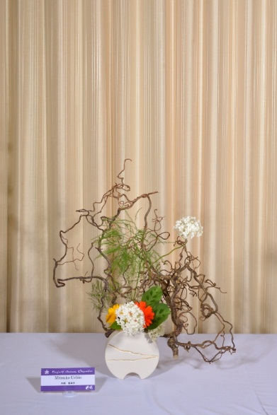
Freestyle by Mitsuko Uchio

Slide 17
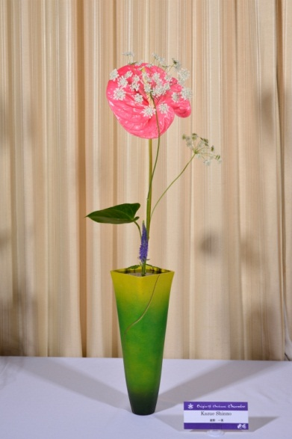
Shoka Shimputai by Kazue Shinno

Slide 18
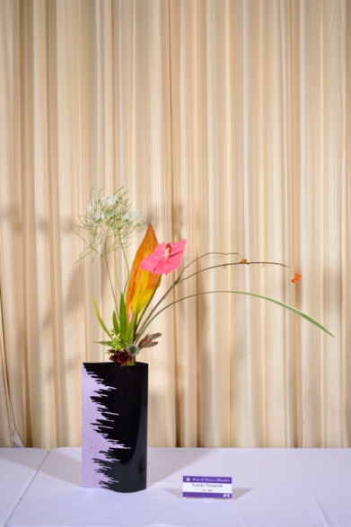
Rikka Shimputai by Tomoko Taniguchi

Slide 19
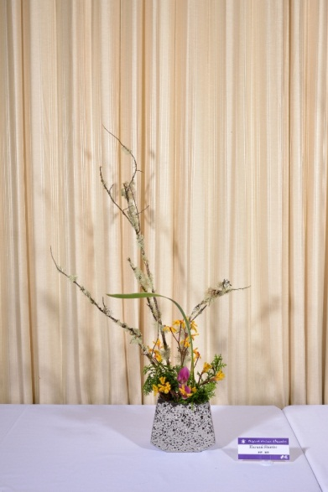
Freestyle by Harumi Shimbo

Slide 20
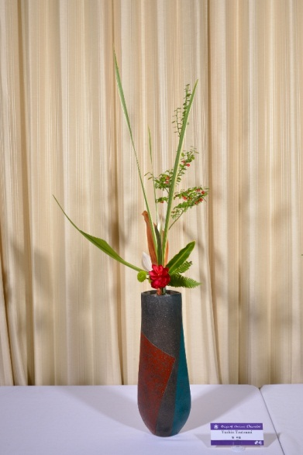
Rikka Shimputai by Yushin Tsutsumi

Slide 21
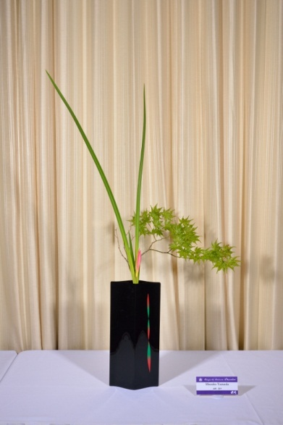
Shoka Shimputai by Masako Yamada

Slide 22
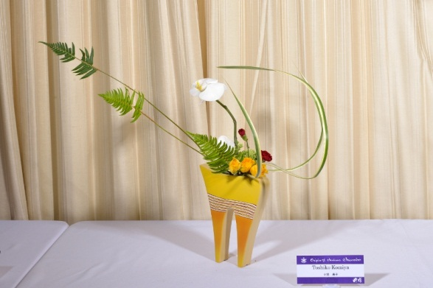
Freestyle by Toshiko Komiya

Slide 23
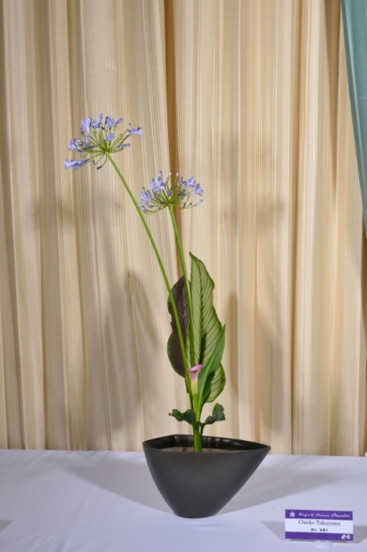
Shoka Shimputai by Chieko Takayama

Slide 24
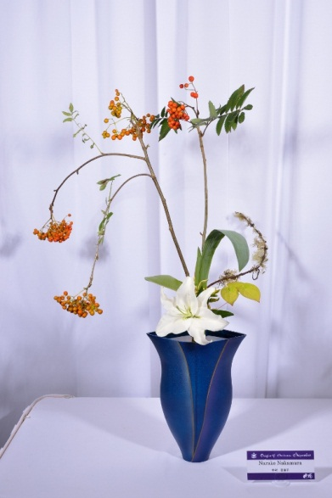
Shoka Shimputai by Narako Nakamura

Slide 25
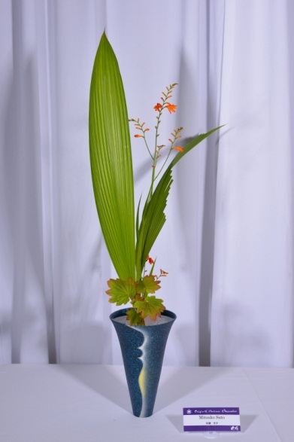
Shoka Shimputai by Mitsuko Sato

Slide 26
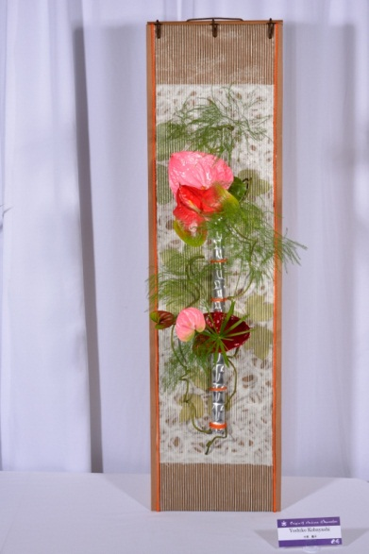
Freestyle by Yoshiko Kobayashi

Slide 27
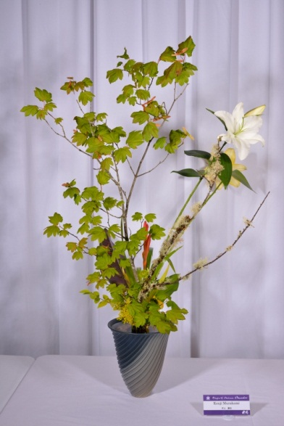
Rikka Shimputai by Kenji Murakami

Slide 28
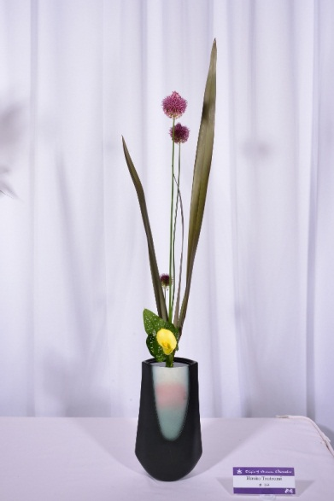
Shoka Shimputai by Hiroko Tsutsumi

Slide 29
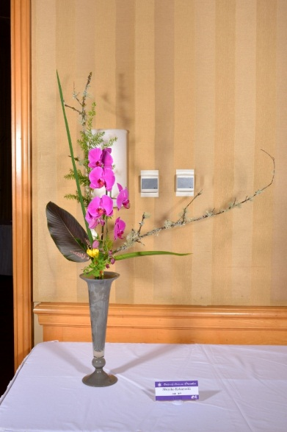
Rikka Shimputai by Shigeko Kobayashi

Slide 30
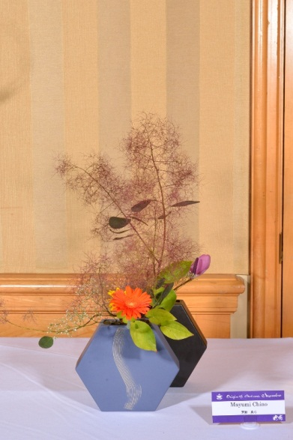
Freestyle by Mayumi Chino

Slide 31
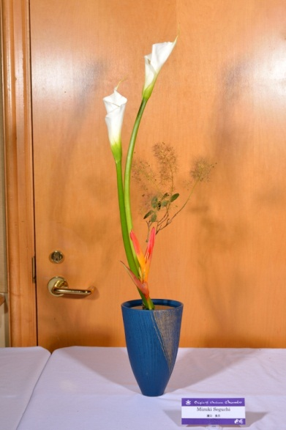
Shoka Shimputai by Mizuki Seguchi

Slide 32
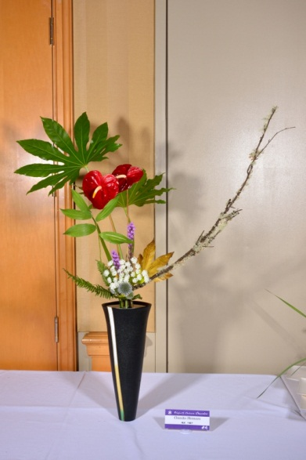
Rikka Shimputai by Chizuko Shimazu

Slide 33
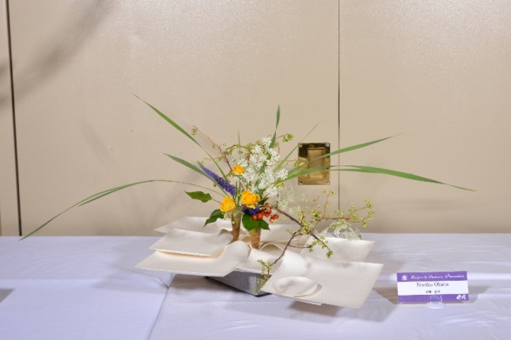
Freestyle by Noriko Obata

Slide 34
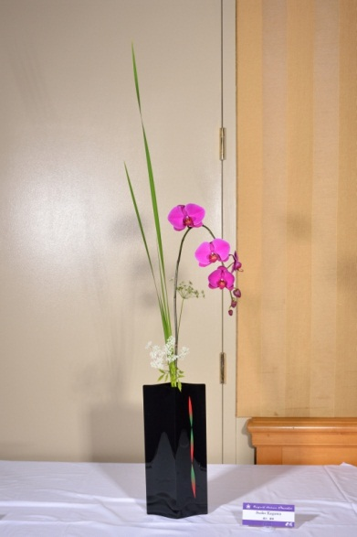
Shoka Shimputai by Suiko Kagawa

Slide 35
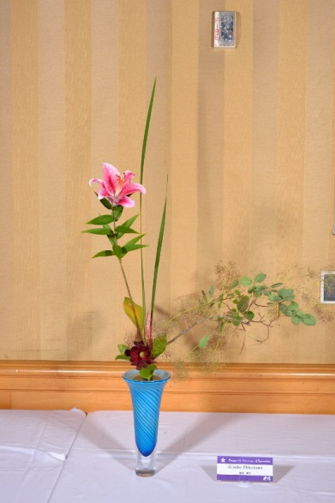
Rikka Shimputai by Jitsuko Shinohara

Slide 36
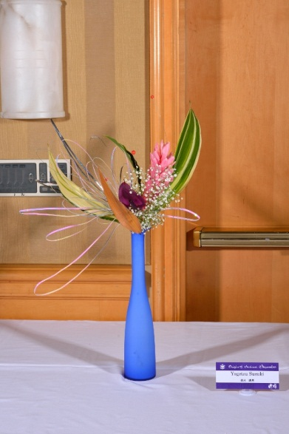
Freestyle by Yogetsu Suzuki

Slide 37
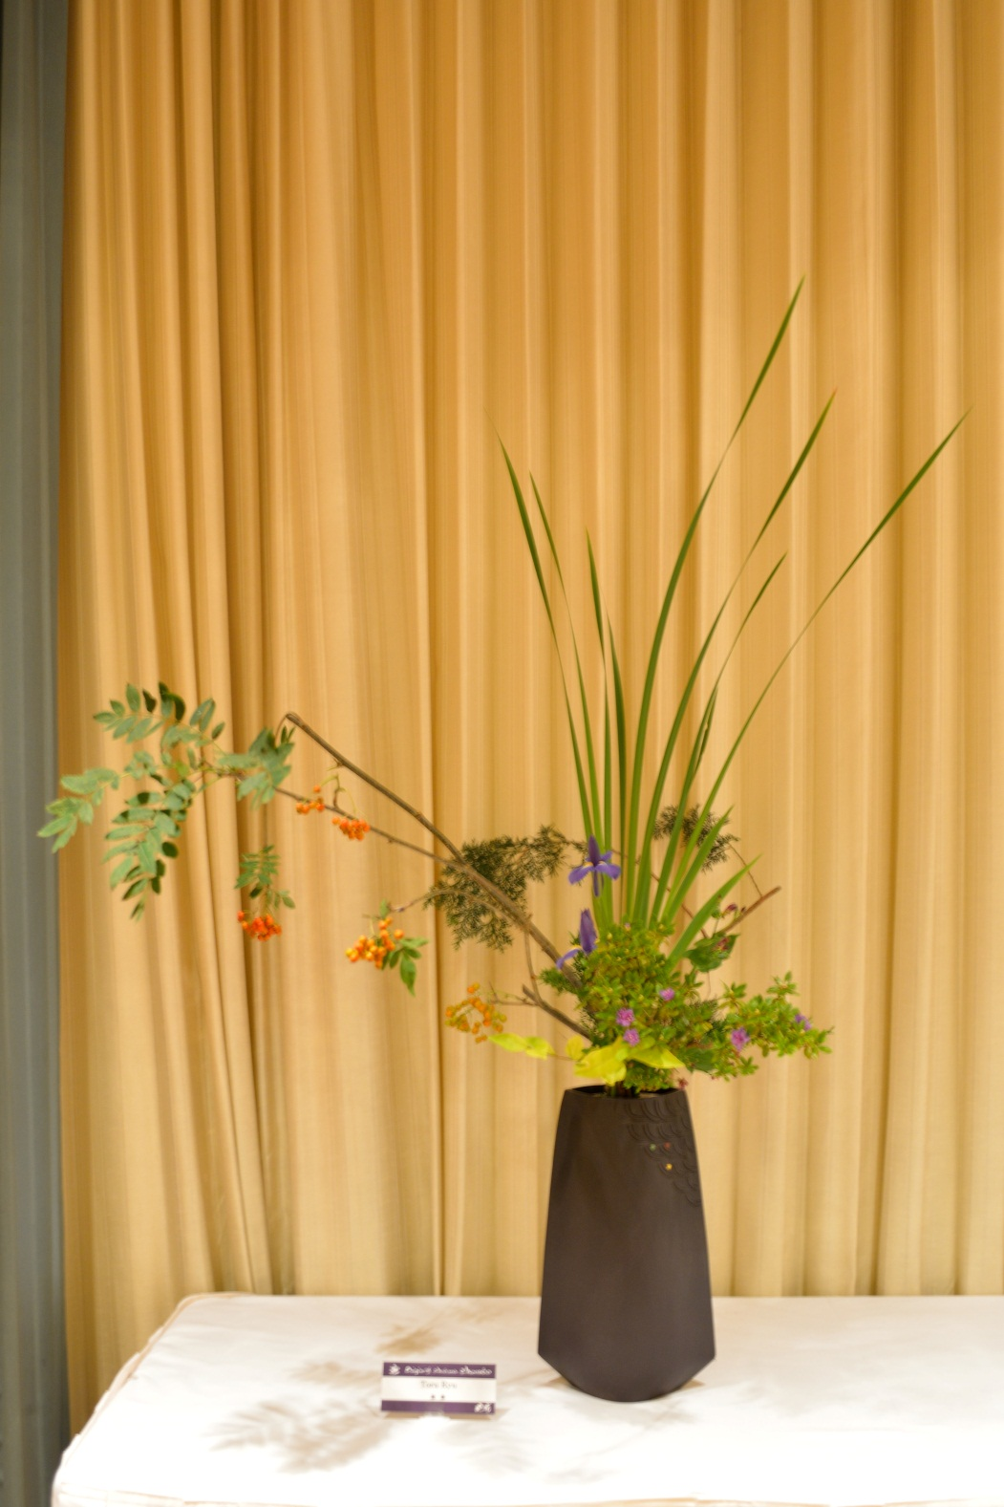
Rikka Shimputai by Toru Ryu

Slide 38
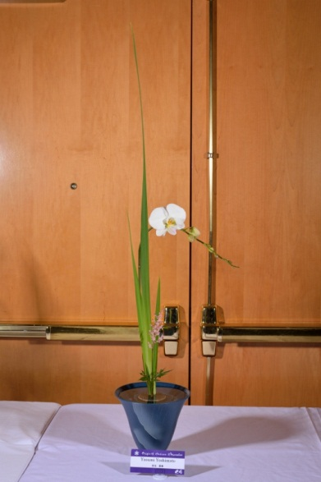
Shoka Shimputai by Yasumi Yoshimoto

Slide 39
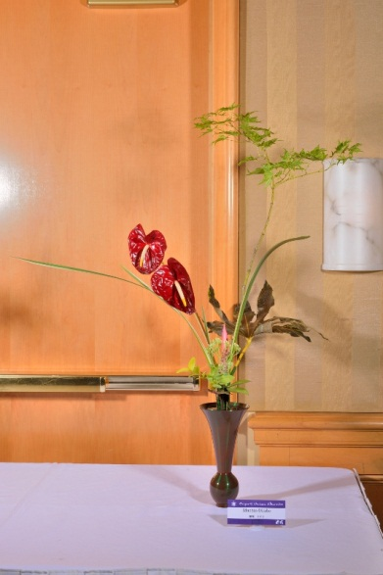
Rikka Shimputai by Machio Okabe

Slide 40
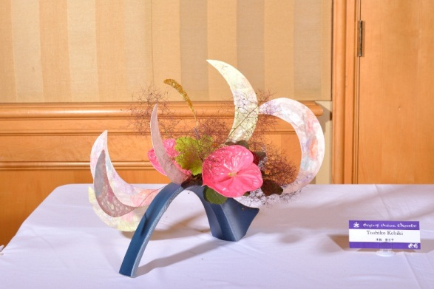
Freestyle by Toshiko Kobiki

Slide 41
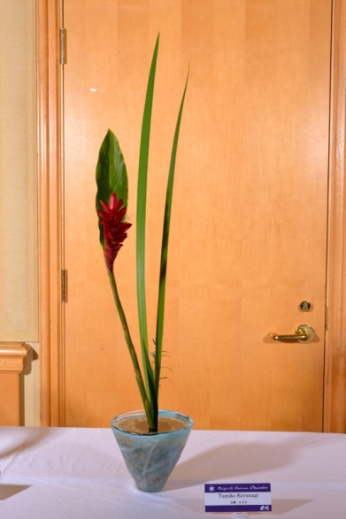
Shoka Shimputai by Tamiko Koyanagi

Slide 42
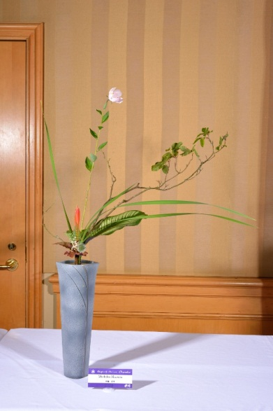
Rikka Shimputai by Michiko Murata

Slide 43
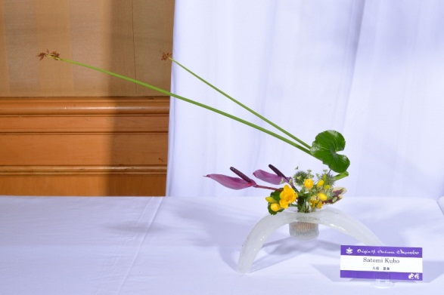
Freestyle by Satomi Kubo

Slide 44
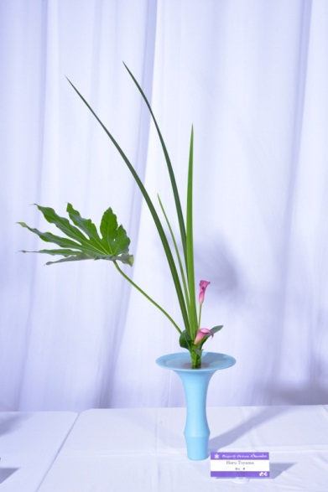
Shoka Shimputai by Haru Toyama

Slide 45
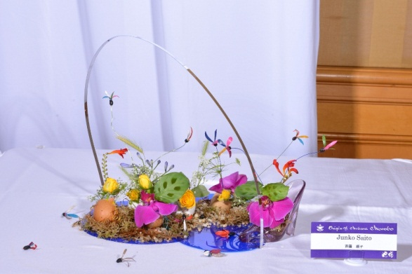
Freestyle by Junko Saito

Slide 46
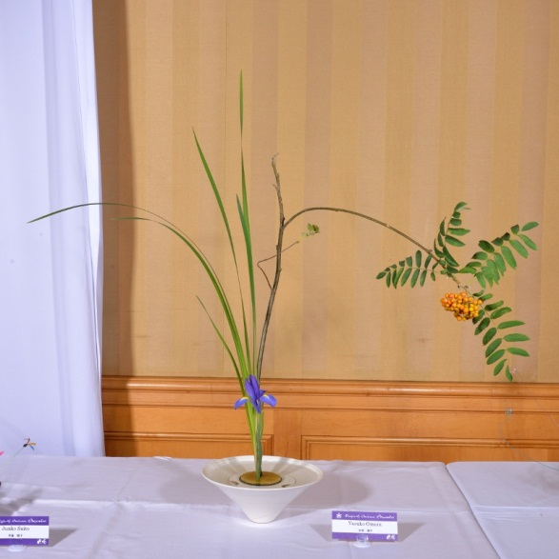
Shoka Shimputai by Yasuko Omura

Slide 47
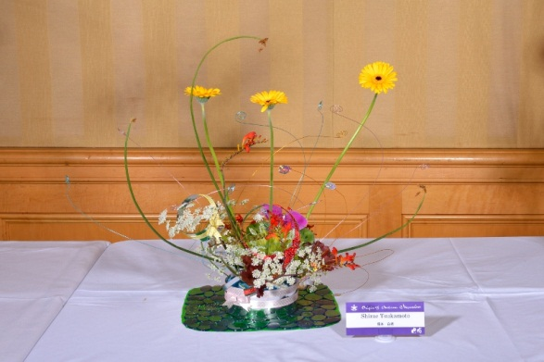
Freestyle by Shirae Tsukamoto

Slide 48
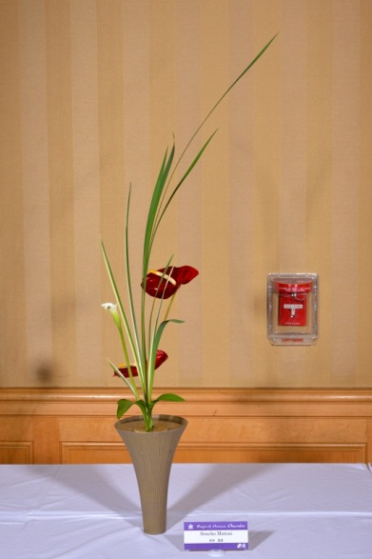
Shoka Shimputai by Sencho Matsui

Slide 49
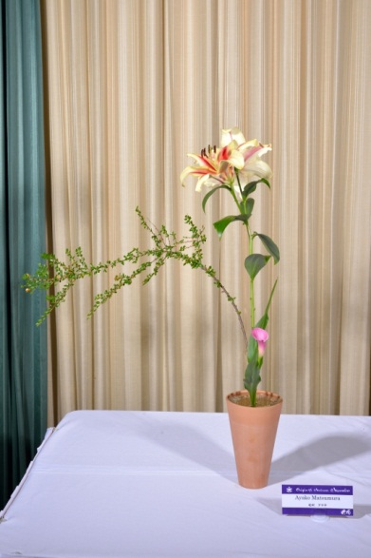
Shoka Shimputai by Ayako Matsumura

Slide 50
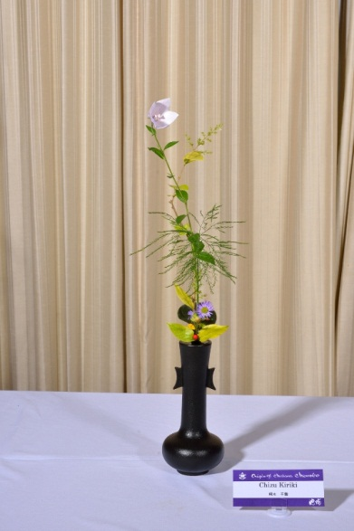
Tatebana by Chizu Kiriki

Slide 51
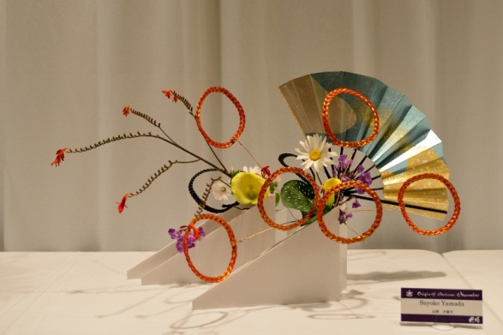
Freestyle by Sayoko Yamada

Slide 52
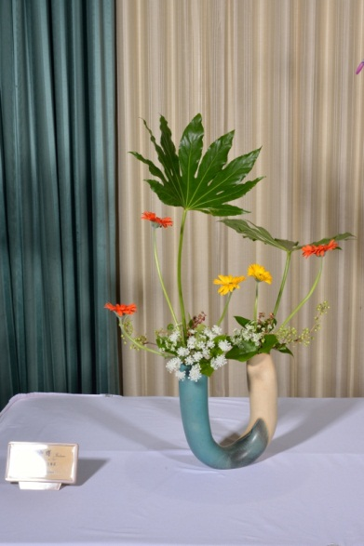
Freestyle by Hiroko Faulkner

Slide 53

Rikka Shimputai by Nancy Evans

Slide 54

Freestyle by Joan Crummett

Slide 55

Shoka Shofutai by Gitte Coleman

Slide 56

Rikka Shimputai by Peggy Booth

Slide 57

Shoka Shimputai by Kazuko Bill

Slide 58

Freestyle by Victoria Bestock

Slide 59

Shoka Shofutai by Diana Leung

Slide 60

Freestyle by Naomi Takagi

Slide 61

Freestyle by Hyun-Son Shin

Slide 62

Shoka Shimputai by Sharonne Shimizu

Slide 63

Freestyle by Keiko Arakane

Slide 64

Shoka Shimputai by Rika Amdahl

Slide 65

Rikka Shimputai by Elaine Stamm

Slide 66

Freestyle by Beatrice Lam

Slide 67

Shoka Shofutai by Kayoko Fujita

Slide 68

Freestyle by Jeanne Fujii

Slide 69

Shoka Shofutai by Sharon Chong

Slide 70

Rikka Shimputai by Shigeko Price

Slide 71

Rikka Shimputai by Vera Smiley

Slide 72

Shoka Shofutai by Joan Stamm

Slide 73

Shoka Shimputai by Fay Tanagi

Slide 74

Shoka Shimputai by Betty Woo

Slide 75

Shoka Shimputai by Joyce Nakamura

Slide 76

Rikka Shimputai by Rose Scott

Slide 77

Shoka Shofutai by Junko Whitaker

Slide 78

Shoka Shimputai by Pearl Umetsu

Slide 79

Shoka Shofutai by Miriam Tong

Slide 80

Rikka Shimputai by Rosario Hanna

Slide 81

Shoka Shimputai by Kazuko Kawachi

Slide 82

Shoka Shimputai by Kathleen Kellogg

Slide 83

Freestyle by Chiyako Nakatani

Slide 84

Freestyle by Robin Miyata

Slide 85

Shoka Shimputai by Arlene Nakamaru

Slide 86

Shoka Shofutai by Sara Kosugi

